Slide 1
What’s in a GPA? Calculating Comparable Results from International Transcripts
NAFSA Region XII Conference, Honolulu, HI 2015
Aleks Morawski
Foreign Credits, Inc.

Slide 2
Documentation Types
Types
  Transcripts
  Diploma Supplements
  Mark Sheets
  Course certificates
From
  Degree-granting institution
  Teaching institution
  Examination Board, Ministry of Education, etc.

Slide 3
Considerations
Final, Provisional, Predicted?
Examination or coursework grades?
Multiple grades (words, letters, #s)
  What should we be converting?
What does this country/system report, or omit?

Slide 4
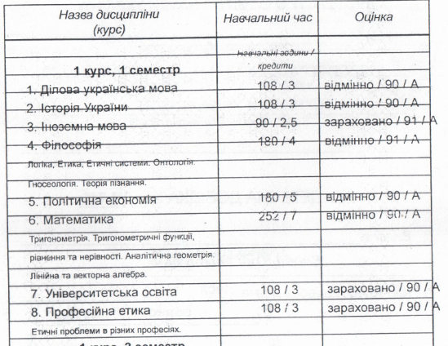
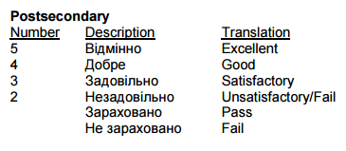
Pass, 90, or A?
S Grade, or Excellent?

Slide 5
What counts, What doesn’t?
In certain countries, not all grades are counted toward the “overall grade”
  Eg. South Korea, Philippines, etc.
Failed grades are not reported until a student passes
  Eg. Russia
Failed attempts can be recorded on individual statements, but not on consolidated, or final statements
  Eg. India
What happens at your institution when a student fails a course, or repeats it for a passing/higher grade?

Slide 6
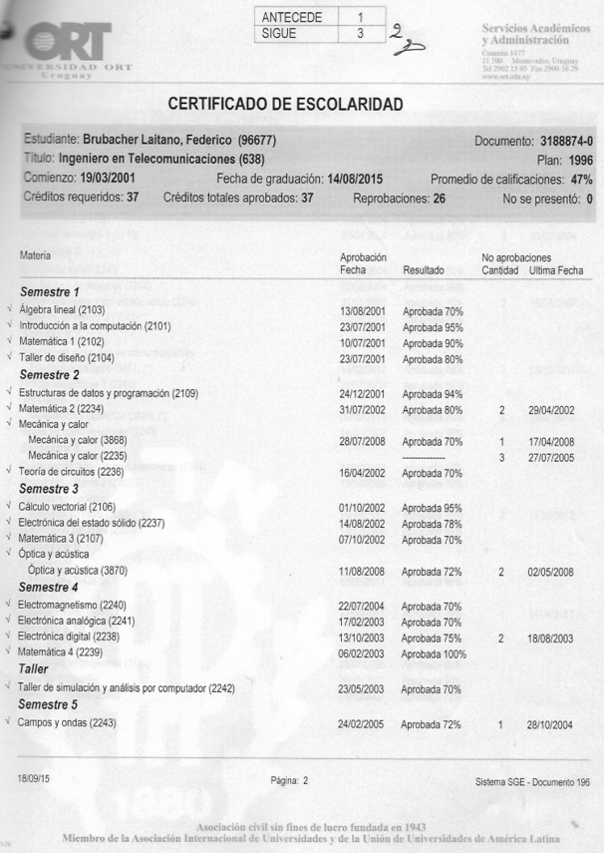
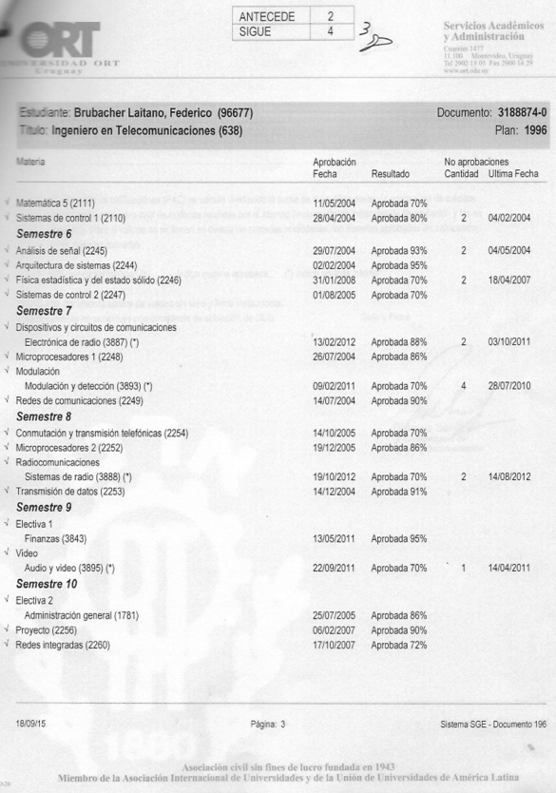
So many attempts, what would you do?

Slide 7
What else is there?
Class Rank
Trends
Degree Classification/Overall grades
Divisions / Classes
Honors or Honours

Slide 8
Grading in the United States
Letter grades most common
  A, B, C, D, F
Other options – percentages, numbers, word descriptions
Pass/Fail
Letter grades have no relationship with quantitative performance measurement
  60-69%=C at one institution, or 60-69%=D elsewhere

Slide 9
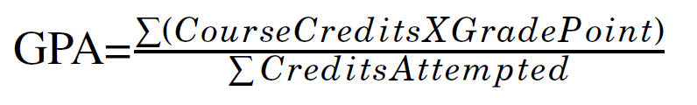
Grade Point Average (GPA)
GPA = The mathematical average of the sum of grade points factored by the total number of credits attempted
  Weighting: Semester Credits, Quarter Credits, Hours, Carnegie Units, etc.

Slide 10
Where do these numbers come from?
Grade Points = numerical value assigned to each letter grade (at your institution)
Quality Points = Grade points multiplied by the number of credits, or weight of a course
Course | Credits | Grade | QPts
Chemistry I | 4 | A | 16
English I | 3 | B | 9

Slide 11
US Grading Scales
Basic
Grade | Achievement | Point Value
A | Superior | 4.0
B | Good | 3.0
C | Satisfactory | 2.0
D | Marginal | 1.0
F | Failing | 0.0
San Diego State University, University of Hawaii Manoa
Grade | Point Value
A | 4.0
A- | 3.7
B+ | 3.3
B | 3.0
B- | 2.7
C+ | 2.3
C | 2.0
C- | 1.7
D+ | 1.3
D | 1.0
D- | 0.7
F | 0.0
Marquette University UG
Grade | Achievement | Point Value
A | Superior | 4.0
AB |  | 3.5
B | Good | 3.0
BC |  | 2.5
C | Satisfactory | 2.0
CD |  | 1.5
D |  | 1.0
F | Failing | 0.0

Slide 12
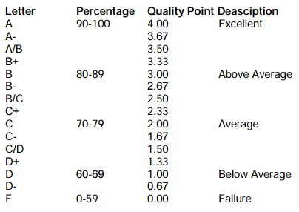
More US grading scales
NAFSA Online Guide to Educational Systems Around the World – United States of America
Foreign Credits, Inc.
Grade | Point Value
A | 4.0
A- | 3.7
B+ | 3.3
B | 3.0
B- | 2.7
C+ | 2.3
C | 2.0
C- | 1.7
D+ | 1.3
D | 1.0
D- | 0.7
F | 0.0
Description

Slide 13

Practice Time
Class | Grade | Credits
Mathematics I | C | 3
English I | B | 3
History | A | 3
French | B | 3
Kayaking | A | 1
Music | B | 1
 |  | 14
Grade Points | QPts | Total
2.0 | 6.0
3.0 | 9.0
4.0 | 12.0
4.0 | 9.0
4.0 | 4.0
1.0 | 3.0
 | 43.0
$$GPA=\frac{43.0}{14}=3.071…$$

Slide 14
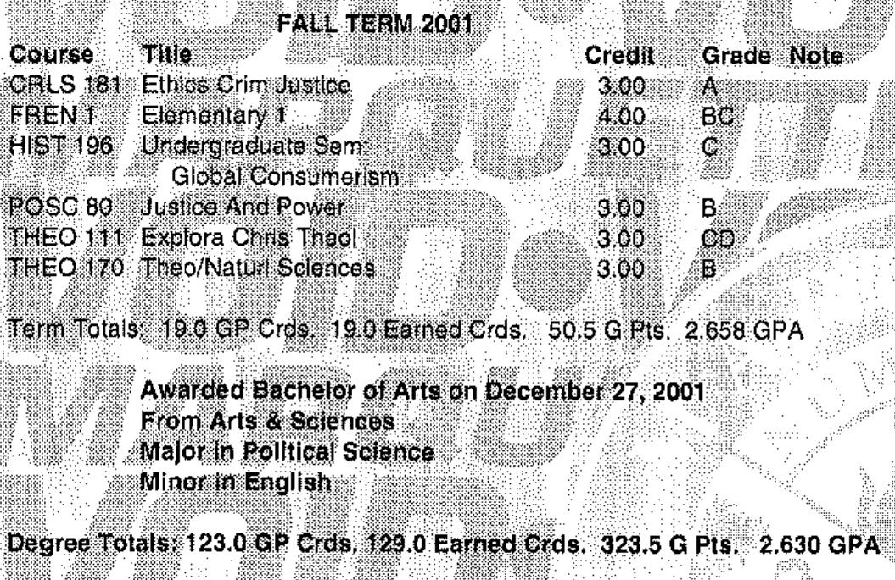
Marquette University UG
Grade | Point Value
A | 4.0
AB | 3.5
B | 3.0
BC | 2.5
C | 2.0
CD | 1.5
D | 1.0
F | 0.0
Answers Behind Here

Slide 15
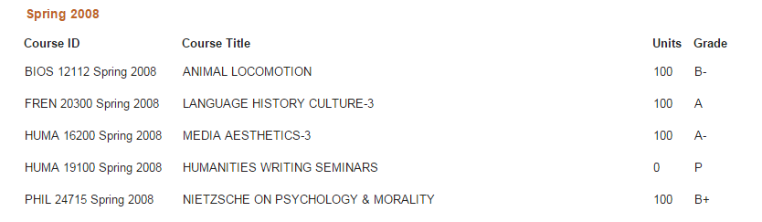
Using what we learned, what GPA do you get?
Grade | A | A- | B+ | B | B- | C+ | C | C- | D+ | D | D- | F | P
Point Value | 4 | 3.7 | 3.3 | 3 | 2.7 | 2.3 | 2 | 1.7 | 1.3 | 1 | 0.7 | 0 | ?
Answer: 3.43

Slide 16
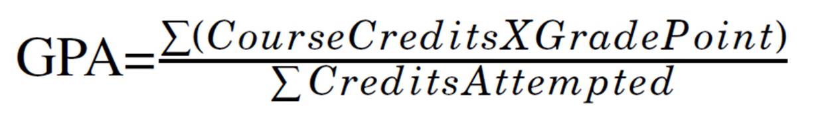
Foreign Transcripts
Step 1: Convert foreign grades to US grades
  Modify the Scale to fit that of your institution
Step 2: Convert Credits*
Step 3: Multiply credits by grade points for each course, and add them together
Step 4: Follow your GPA formula just like a US transcript

Slide 17
Grade Conversion Resources
Internal country pages
  Table of Contents and sample can be found: http://www.nafsa.org/Find_Resources/Supporting_International_Students_And_Scholars/Network_Resources/International_Enrollment_Management/Table_of_Contents_Template_for_Credential_Evaluation_Manual/
NAFSA Online Guides to Education Systems Around the World http://www.nafsa.org/Resource_Library_Assets/Publications_Library/Online_Guide_to_Educational_Systems_Around_the_World/
Print Publications (Pier Guides, ECE Presents, Etc.)
Online Databases (AACRAO EDGE, GRADE Database, Classbase, Etc.)

Slide 18
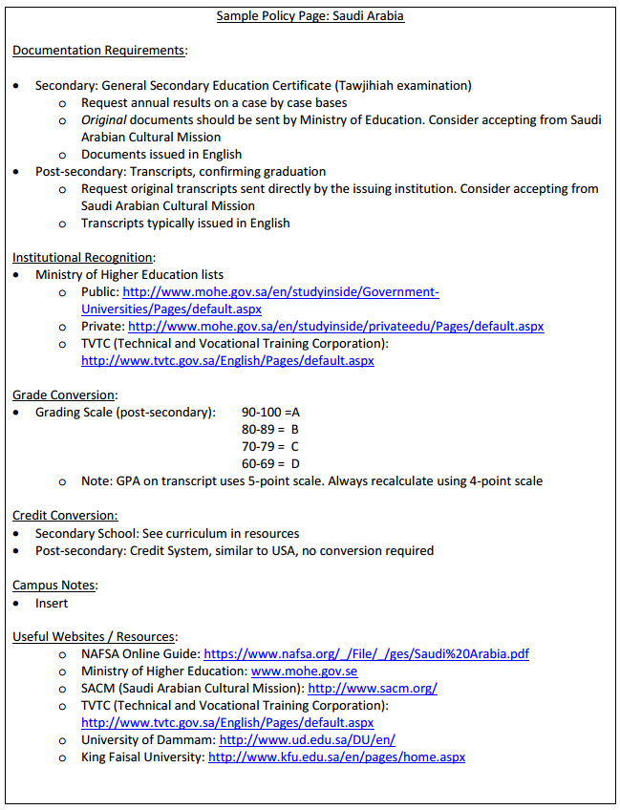
Table of Contents Template for Credential Evaluation Manual
Sample – Saudi Arabia

Slide 19
Other Free, Electronic Resources
Classbase:
http://www.classbase.com/
WES Country Profiles:
http://www.wes.org/wes_tools/profile.asp
NCAA International Standards
https://www.ncaapublications.com/p-4359-international-standards-2014-2015-guide-to-international-academic-standards-for-athletics-eligibility-updated-july-2014.aspx
Alberta International Education Guides:
http://work.alberta.ca/Immigration/international-education-guides.html
NUFFIC
https://www.nuffic.nl/en/diploma-recognition/foreign-education-systems/foreign-education-systems
NORRIC Publications:
http://norric.org/publications/publications#countries
Non-US

Slide 20


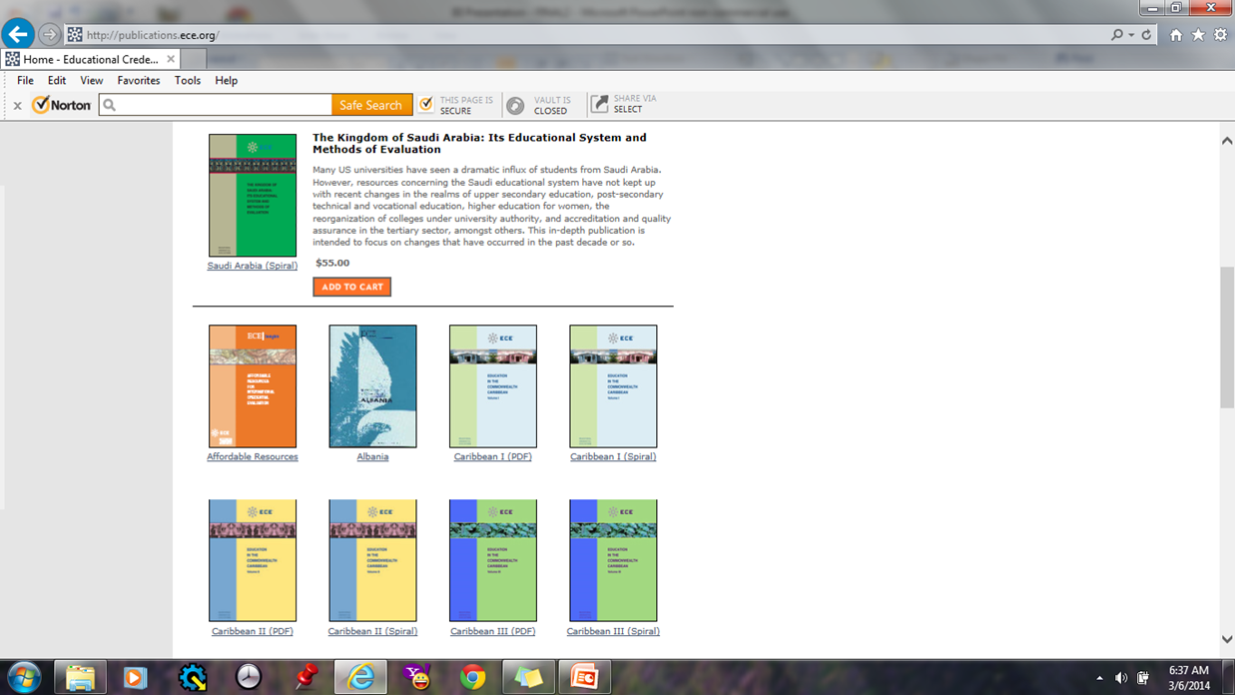
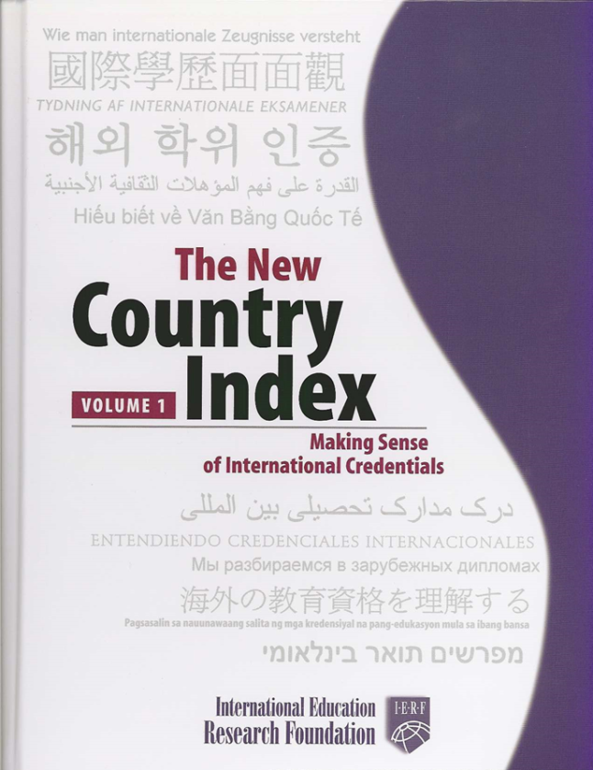

Slide 21
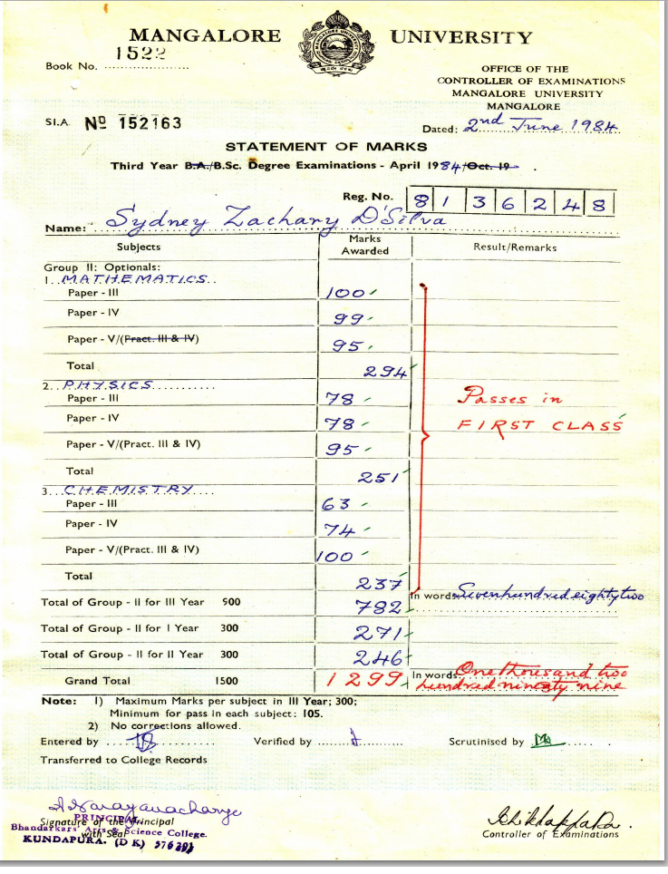
India

Slide 22
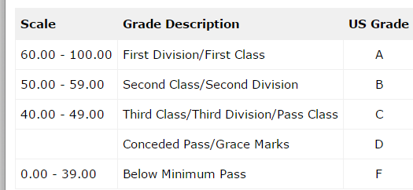
* Please note, minimum pass can vary, typically between 30 and 40
http://www.classbase.com/Countries/India/Grading-System
1. Max Marks = 300 per subject/Min Marks= 105 (35%)
2. Mathematics: 294/300 = 98%
Physics: 251/300= 83%
Chemistry: 237/300= 79 %
3. 98=A, 83=A, 79=A

Slide 23
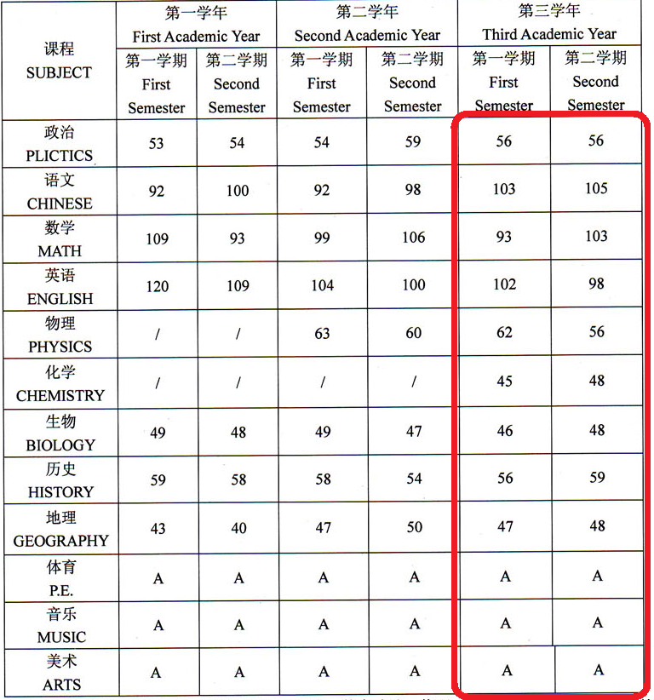
China
Failure?
? / ?
Grading Scale:
90-100 优
80-89 良
70-79 中
60-69 及格
0-59 不及格
A? / ?
? / A?
D / Failure?
Failure?
Failure?
Failure?
Failure?

Slide 24
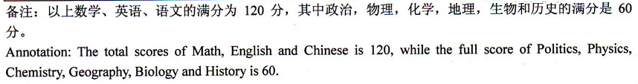
Transcript Legend:
Maximum Scores:
120 – Math, English, Chinese
60 – Other subjects
Grading Scale:
90-100 优
80-89 良
70-79 中
60-69 及格
0-59 不及格

Slide 25
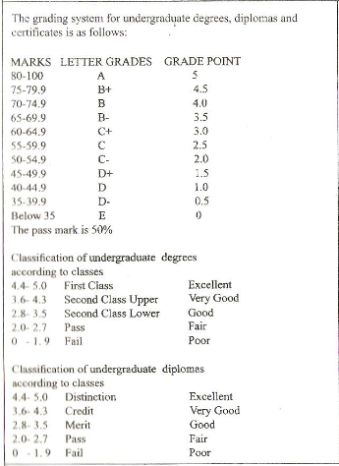

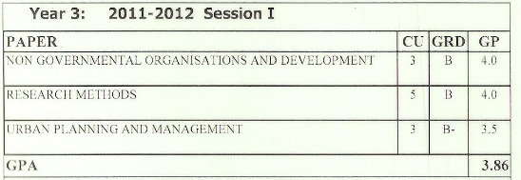
Uganda

Slide 26
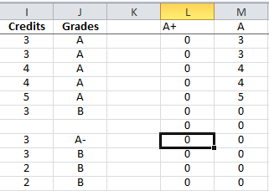
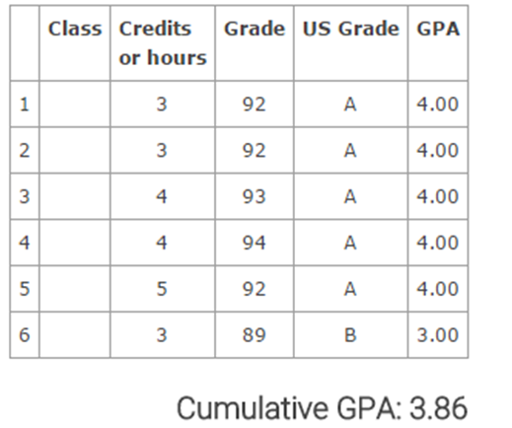
GPA Calculators
Excel-based Calculators
  Any grading scale you input
  Built-in algorithm calculates GPA based on your inputs
  Internal use
  Easily modifiable data
    Can be saved
Online GPA Calculators
  Domestic or international
  Internal or external
  University-based, or third party
  Modifications only by the developer
  Can you save your work?

Slide 27
Excel-based GPA Calculators
Calculating GPAs with Excel or by hand (if your resident Excel pro is busy) is best for international GPA equivalence because:
  Can modify grade inputs based on original institutional scales (don’t need to rely on pre-existing grade conversion charts from third parties)
  Can be used for any country/institution as long as you determine what equates to a US “A”, “B”, “C”, etc.
  Not many options online for international students

Slide 28
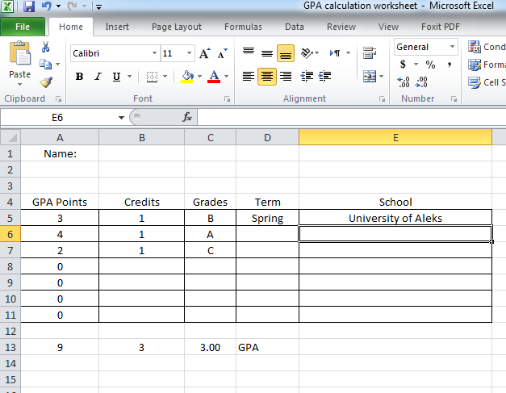
In this version, you must enter Grade Points yourself
Remember to multiply the grade point value by the number of credits
=SUM(A5:A11)
=SUM(B5:B11)
=A14/B14

Slide 29
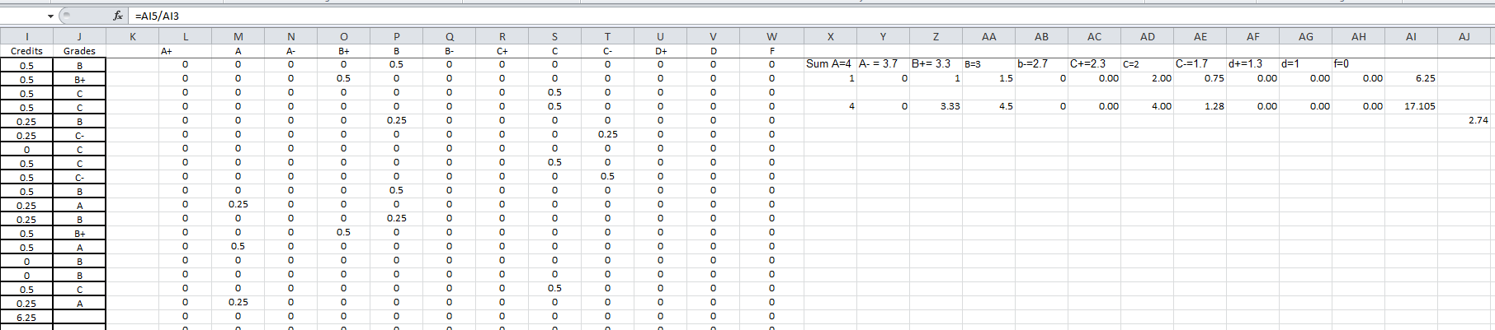
Screen shot of internal, excel-based GPA calculator.
Edit-able, save-able,
Limited information
Less elegant
Works only for one grading scale

Slide 30
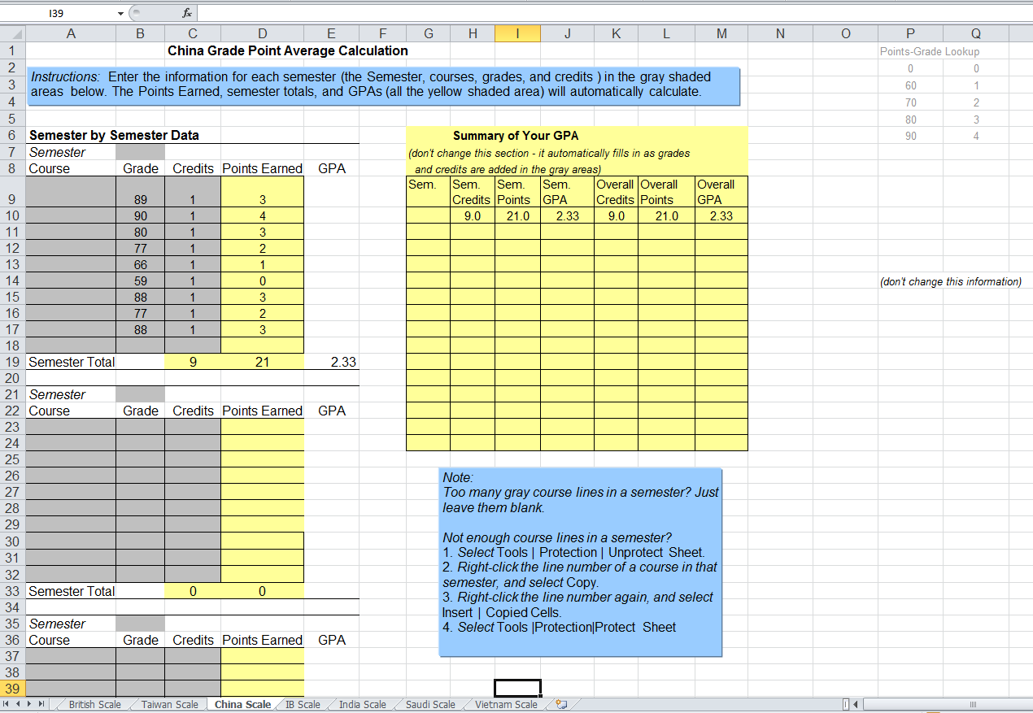
Complex Excel-based Calculator
Multiple Country scales in one workbook
Instructions for staff
Scales still customizable

Slide 31
Online GPA Calculators
Your institution may already have one!
  Usually domestic grading scale only
  Can be tailored to undergraduate or graduate, current students or applicants
  Can be institutionally-based, or link to a third-party website

Slide 32
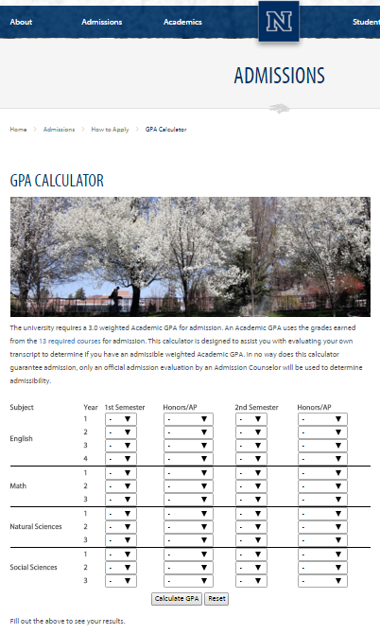
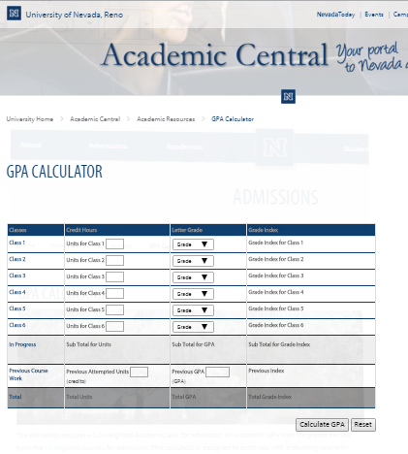
http://www.unr.edu/academic-central/academic-resources/gpa-calculator
http://www.unr.edu/admissions/how-to-apply/gpa-calculator

Slide 33
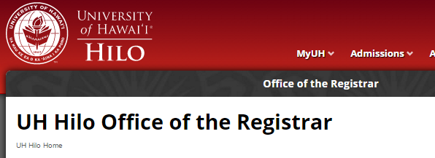
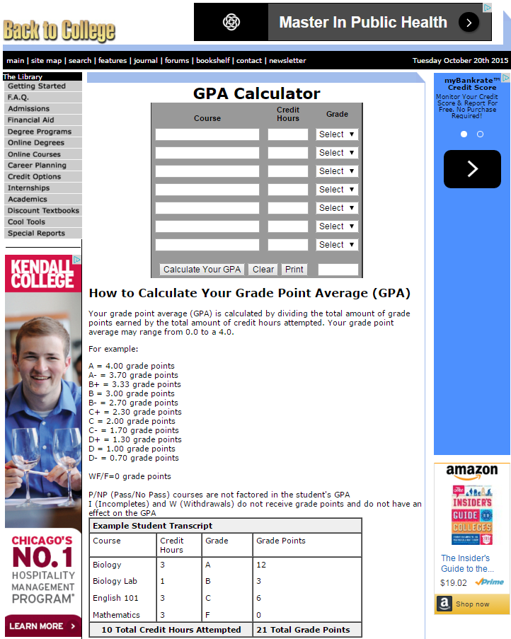
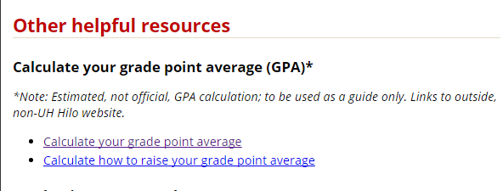
http://hilo.hawaii.edu/registrar/
http://www.back2college.com/gpa.htm

Slide 34
Online GPA Calculators
(International)
Grading scale limited to those input by the administrator
  Not customizable
Can be used by prospective applicants or current students
Large data set required (many grading scales)
Can results be saved?
Free or fee-based?

Slide 35
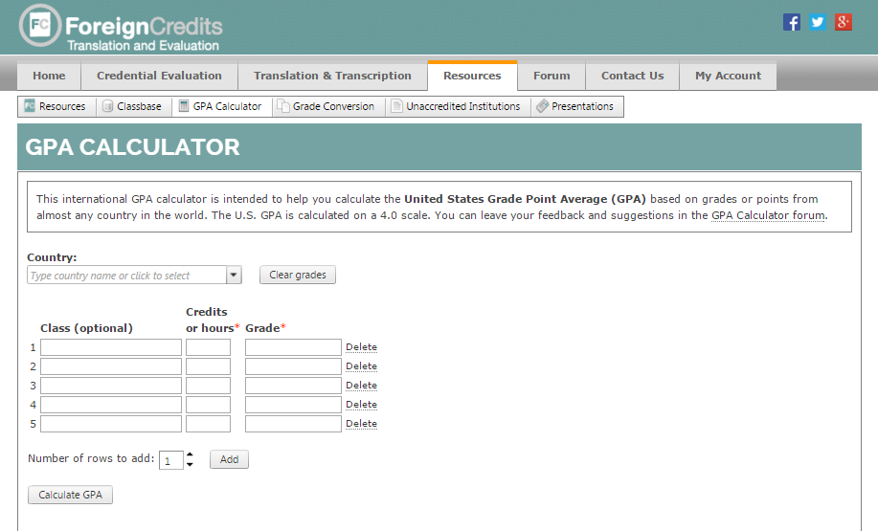
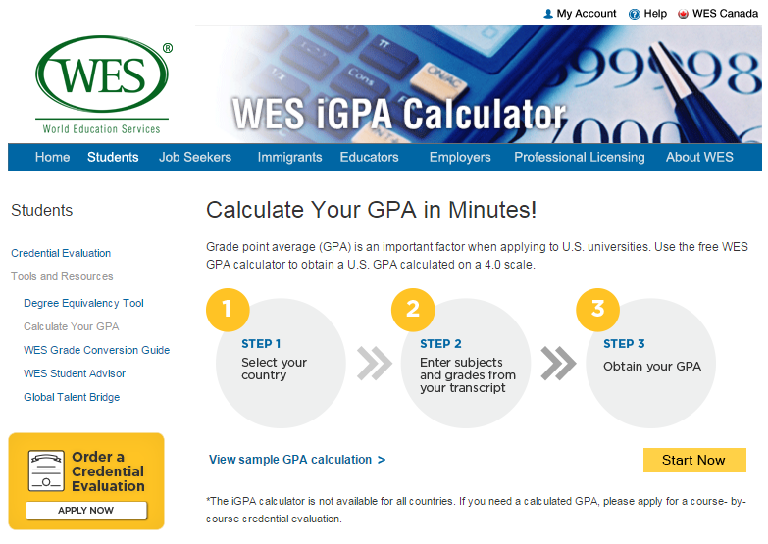
http://www.foreigncredits.com/Resources/GPA-Calculator/
http://www.wes.org/students/igpacalc.asp

Slide 36
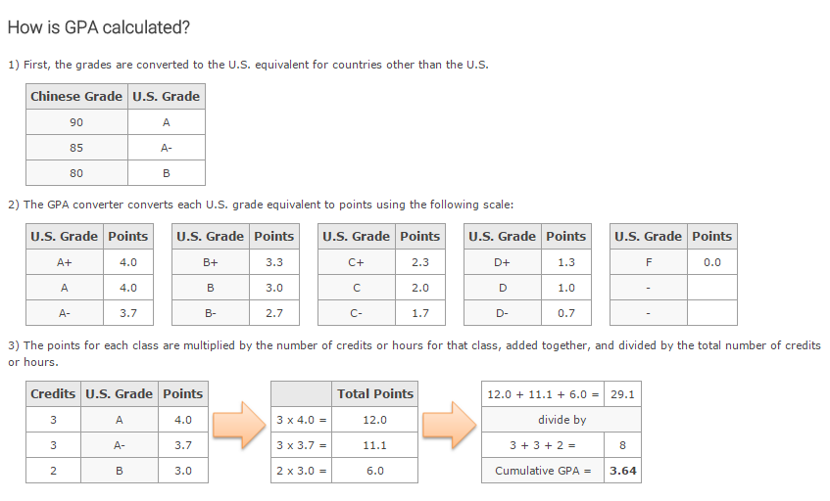

Slide 37
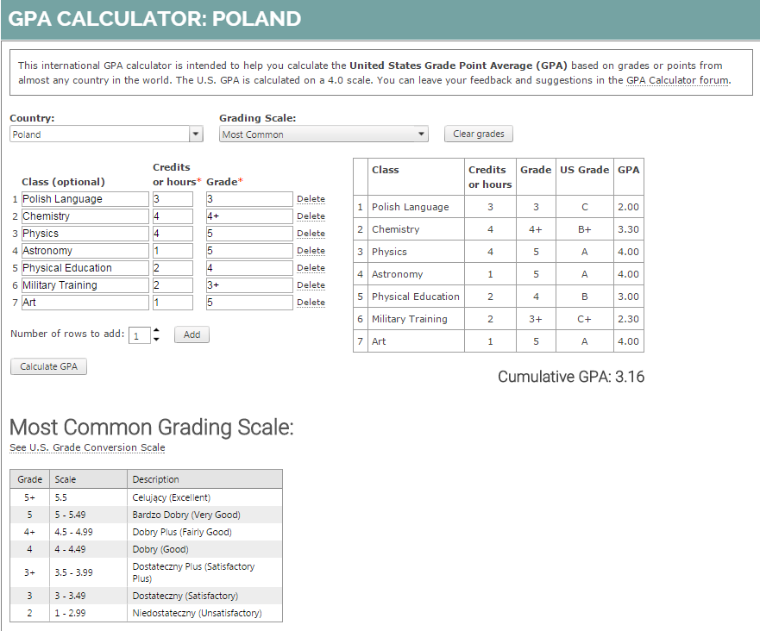
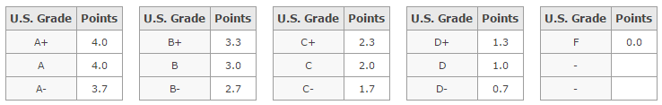
Make sure this works for your credential and your institution

Slide 38
Questions, Comments?
Thank You!!
This presentation is available for download at
http://www.foreigncredits.com/Resources/Presentations/
Aleks Morawski
Director of Evaluation Services
Foreign Credits Inc.
Tel. 847-250-0870
amorawski@foreigncredits.com
Foreign Credits is an Endorsed Member of AICE, the Association of International Credential Evaluators, Inc. ®

