Slide 1


Sharing Strategies for Establishing Yourself in IE Before Earning a Master’s Degree
Sonya Brauchle
International Education Specialist
Foreign Credits, Inc.
Mallory Ericson
Manager of Marketing and Program Advisement
World Endeavors
Ashley Metz
Executive Assistant
University of Minnesota – Learning Abroad Center

Slide 2
Agenda
Introductions
Breaking Into the Field:
Experience Abroad, Language Experience, Local Multicultural Experience, Internships, Undergraduate, Informational Interviews, Non-Field Related Experience, Higher Education, Job Boards and Resources
Establishing Yourself in the Field:
Scholarships, Online Presence, Field Knowledge and Resources, NAFSA, Mentoring
Going Forward:
Networking, Q&A, Discussion

Slide 3
Introductions
1) What was your first job in or related to the field?
2) What type/s of job are you interested in within the field of IE?
3) What do you hope to take away or discuss during this session?

Slide 4
Experience Abroad
Opportunities abroad:
Teaching and Advising
Interning
Volunteer Work
Peace Corps
Study Abroad
Notes:
SONYA
My own experience: China (teaching), Spain (learning), travelling around
Why important? Catalyst to almost everyone entering the field. How do you apply it to your job
Interacting with students
Advising
Working when the students aren't actually there.
What skills do you bring back to your job? Language, interaction, communication, first hand experience - my perspective as a credential evaluator, what I learned about what each country values in their education, very clearly affects everything about the culture.

Slide 5
Experience Abroad
Why is this important?
How does it affect your job day to day?
How about your job search?
Professional Development
What actual ‘skills’ do you bring back to your job?
Communication and Problem Solving
Language Experience
Notes:
Almost every international education job asks for international experience/experience abroad
how do you talk about your experience, what strengths does it build?
not just before your job - short term programs, internships, etc. - be creative - convince your job to support you!
multi cultural sensitivity

Slide 6
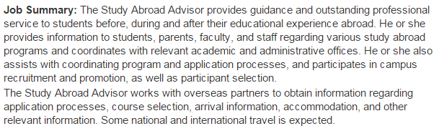
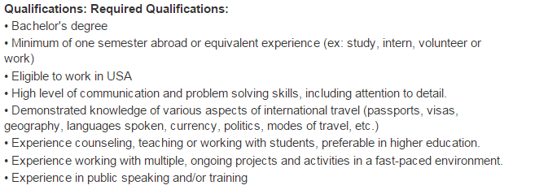
Experience Abroad
Study Abroad Advisor
Bachelor’s degree
Minimum of one semester abroad or equivalent experience (ex. study, intern, volunteer or work)
High level of communication and problem solving skills, including attention to detail
Experience counseling, teaching or working with students, preference in higher education
http://jobregistry.nafsa.org/jobs/7622796/study-abroad-advisor

Slide 7

Language
Why is this important?
How does this assist you in your job?
Communication
Point of view
My experience
Studying language
Hiring advisors

Slide 8
Language
Undergraduate Experience
Major/Minor
Study Abroad
After Graduation
International experience
Immersive Programs
Teaching Abroad
Within your home community

Slide 9

Local Intercultural Experience
Involvement with international student exchange programs
Volunteer as liaison, host a student, help at events, retreats, meetings. etc.
Art
Cultural festivals
Museums and exhibits
Musical performances and events
Events, literary or visual resources at libraries
Documentaries and films

Slide 10
Local Intercultural Experience
Language learning
Local college or university classes
Language partner (through school or organization)
Food
Restaurants
Festivals
Cooking classes through community education
International grocery stores

Slide 11
Internships
Undergraduate
Study Abroad Office
International Student Services
Multicultural Office
Postgraduate
Global Companies/Non-Profit Organizations
Provider Companies
Personal Experience

Slide 12
Informational Interviewing
How do you find professionals to “interview”?
Difference between an informational and job interview
Benefits - long and short term
Notes:
learn about what you like and don’t like
find people that do what you want to do learn habits, get advice, learn how they got there
environments you like - small vs. large
do this even while you’re at your current job

Slide 13
Undergraduate Campus Help
Volunteering in study abroad and/or international student services offices
Helping at study abroad fairs or orientations
Giving classroom presentations about your experiences abroad
Peer mentoring through international student services office programs (ex: IBP at the University of Minnesota)

Slide 14
Non-Field Related Experience
Customer Service
People skills
Patience
Media/Communication
Online research
Familiarity with various programs (ex: Microsoft Office, Adobe)
Budgeting/Finance

Slide 15
Non-Field Related Experience
Event Planning
Web Design and Maintenance
Grant Writing
Blogging
Photojournalism
Social Media
Career Services/Advisement

Slide 16
Experience in Higher Education
Knowledge of departments and offices on campus
Connections with people on campus
Understanding climate and organization of office
Understanding values and goals of office
Experience working with students
Experience with or knowledge of management systems (example: PeopleSoft, Banner)
It’s easier to move within the system than to get in from the outside

Slide 17
Scholarships/Financial Help
Have basic knowledge of financial aid and the Federal Pell Grant (and how they affect students paying to participate on study abroad programs)
Be aware of scholarships available at your current institution/organization/company (or where you hope to work)
Review scholarship applications if/when possible (institutions, organizations, community groups)

Slide 18
Scholarships/Financial Help
Encourage others in your office, organization, and campus to also review applications
Serve on panels for Benjamin A. Gilman International Scholarship Program
Learn about Boren, Fulbright, and other national scholarship opportunities

Slide 19
Building an Online Presence
LinkedIn, Facebook
Everything you do professionally - make sure it’s documented and searchable!
Message Boards, Forums, Listserv
Blogs and Articles
Virtual Networking Groups
Notes:
SONYA - put your presentations online! this will be on www.foreigncredits.com

Slide 20
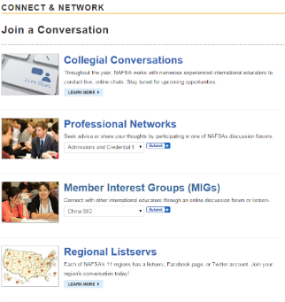
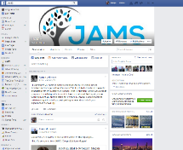
Building an Online Presence
Message Boards and Forums, Virtual Networking
NAFSA Connections
Message Board and Forums
Collegial Conversations
Member Interest Groups
Other Forums and Connections
Virtual Networking Groups

Slide 21
NAFSA: Professional Development
At Conferences:
Regional and National - Volunteering, Grant Opportunities, Present!, Poster Sessions, Leading Workshops/Trainings, Open Meetings
Networking and Professional Development:
Knowledge Communities, NAFSA Academy, Advocacy Day, Volunteer/Team Positions, Trainer Corps, Certifications
Learning Opportunities at Home:
Webinars, Attending Sessions, Resources for your desk, Collegial Conversations

Slide 22
NAFSA: Conference Involvement
How to get involved:
Local, State, Regional, and National level
Funding
Volunteering
Grant Opportunities
Present!, Poster Sessions, Workshops and Trainings
Open Meetings, Regional Updates, etc.

Slide 23
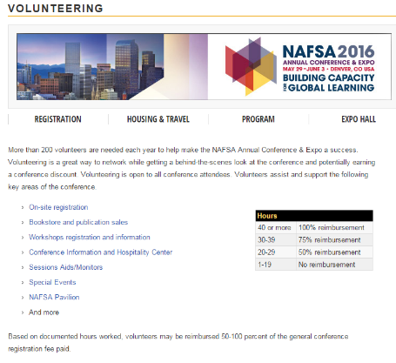
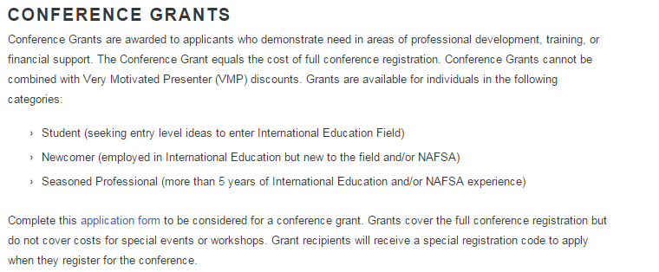
NAFSA: Volunteering and Grants
http://www.nafsa.org/Attend_Events/Annual_Conference/Registration/Volunteering/

Slide 24
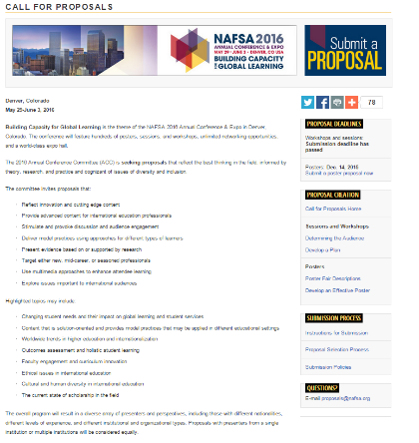
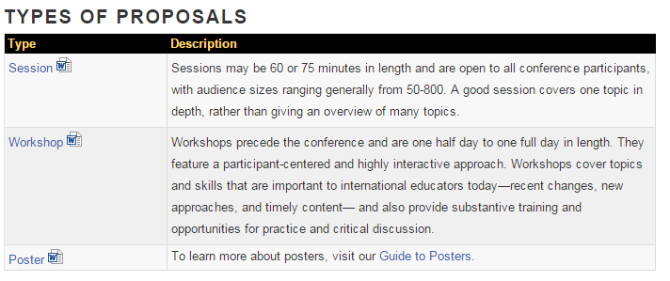
NAFSA: Presenting
http://www.nafsa.org/Attend_Events/Annual_Conference/Call_For_Proposals/

Slide 25
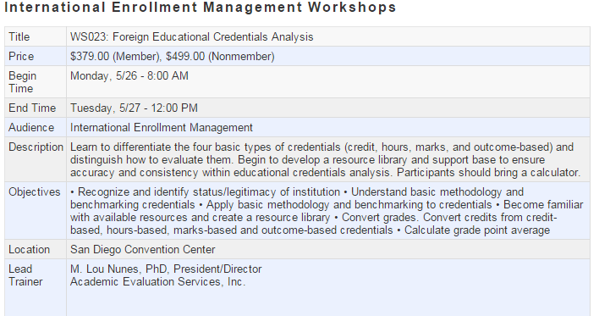
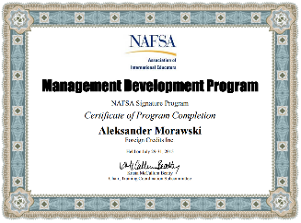
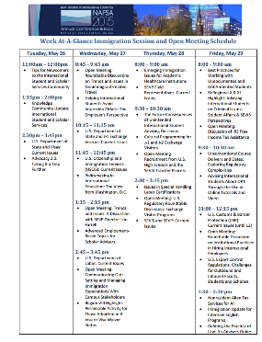
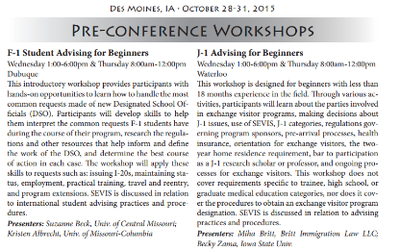
NAFSA: Workshops/Trainings, Open Meetings, and Certifications
Notes:
list all certificates, etc. on resume - not just for leading; specialized

Slide 26
NAFSA: Networking Strategies
Knowledge Communities
Formal Training
NAFSA Academy and Trainer Corps
Advocacy - Advocacy Day
Volunteer/Team Positions
http://www.nafsa.org/Attend_Events/Annual_Conference/Networking_Opportunities/

Slide 27
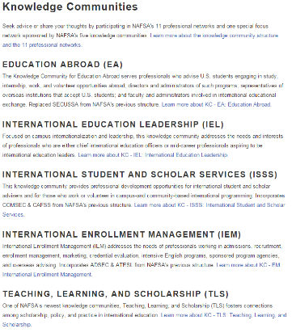
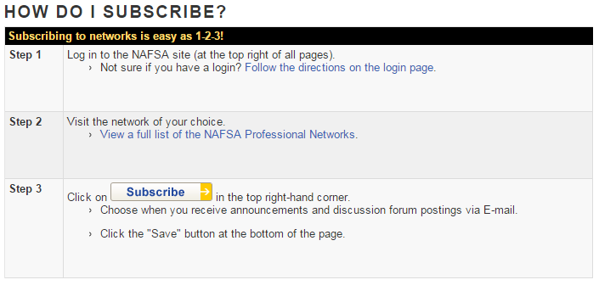
NAFSA: Knowledge Communities
http://www.nafsa.org/Connect_and_Network/Engage_with_a_Community/Using_NAFSA_Networks/

Slide 28





General Field Knowledge and Resources – International Level

Slide 29

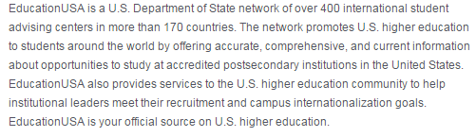

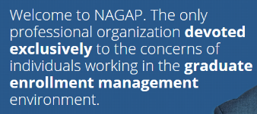




General Field Knowledge and Resources – National Level
http://www.aacrao.org/home

Slide 30


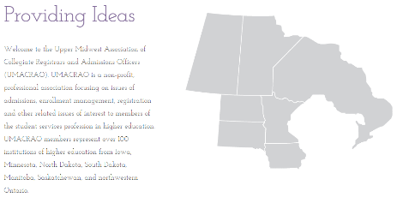

General Field Knowledge and Resources – Regional Level
http://www.umacrao.com/
http://www.miiie.org/

Slide 31
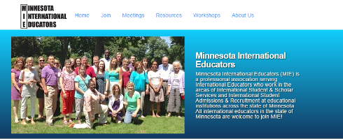




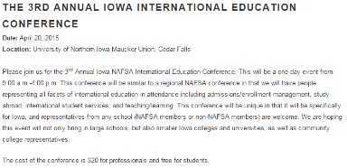

General Field Knowledge and Resources – State Level
http://studymissouri.net/
http://ieillinois.org/iei/
http://ieillinois.org/iei/

Slide 32





Young Professional Networks

Slide 33
Job Boards
Inside Higher Ed Jobs (higheredjobs.com; careers.insidehighered.com)
Chronicle of Higher Education (chroniclevitae.com/job_search/new)
NAFSA Career Center and Job Registry (jobregistry.nafsa.org/jobs)
The Pie Jobs (thepiejobs.com)
TIE Online (tieonline.com)
AACRAO Jobs Online (jobs.aacrao.org)

Slide 34
Resources to Bookmark
Chronicle of Higher Education and Global Newsletter (http:chronicle.com/section/Newsletters/85)
Institute of Higher Education
Inside Higher Ed
NAFSA Blog (http:blog.nafsa/org)
PIE News (thepienews.com)
Better Abroad (betterabroad.org)
What’s Up with Culture (www2.pacific.edu/sis/culture/)
Institute for Higher Education Policy (ihep.org)

Slide 35
Mentoring
Benefits of a Mentor
Where to Find Mentors?
Undergrad Experience
Information Interviews
International Educator Groups
NAFSA Conferences/Workshops
NAFSA Academy

Slide 36

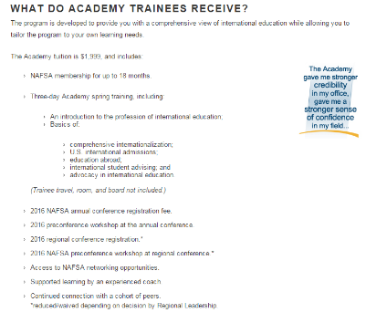
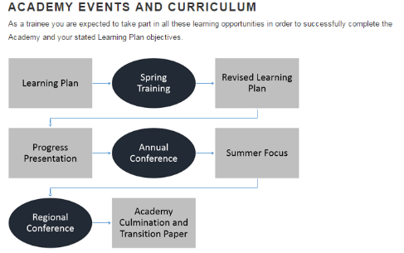
NAFSA Academy
Notes:
formal training - cheaper than a master’s and well known in the field; a nice alternative to tuition reimbursement.

Slide 37
Graduate School
Things to consider before starting a graduate program:
What are your career goals?
Is it financially feasible? Can you get financial assistance through work rather than taking out loans?
Consider programs that balance personal interests as well as prepare you for your field of choice.
Sometimes it’s just about the “M” on job applications.
Sometimes it’s just about gaining experience in the world of higher education.
Sometimes it’s just about your ability to work hard and persevere through challenges, to ”prove yourself”.

Slide 38
Mock Networking “Reception”
How did you get your first job?
What is your 2 minute pitch?
When you meet someone new at a reception, you may have only 2 minutes to convey who you are, what you do, and why you are worth talking to.
Business card exchange
What are the best questions to ask? What questions have you been asked that you were impressed by?

Slide 39

Questions?

Slide 40
Contact Us:
Sonya Brauchle with Foreign Credits, Inc.
sonya.brauchle@gmail.com
Mallory Ericson with World Endeavors
mallory.ericson@worldendeavors.com
Ashley Metz with the University of Minnesota – Learning Abroad Center
armetz@umn.edu

