Slide 1

Electronic Verification of Foreign
Educational Credentials:
Resources and Strategies
Quentin Law Phu, Foreign Credits, Inc.
Kelly Sumner, Indiana University-Purdue University Indianapolis

Slide 2


Outline
Introduction
Types of verification systems and examples
Discussion of related policy and practice in a university admissions office
Questions/comments

Slide 3
Resources for Electronic Verifications
Two Types:
Institutional – In-house electronic verification systems (e.g. foreign colleges, universities)
Governmental – electronic verification systems (e.g. national examination bodies / boards, Ministries of Education, other national education authorities)

Slide 4
Institutional
Verify foreign credential documents to confirm graduation status by searching for student ID number, certificate number, registration number, student’s name (Most common, e.g. King Saud University, Universidad Tecnológica de Chile INACAP, Lovely Professional University, Tsinghua University)
Verify documents to confirm graduation status by looking up student’s name and final grade average in archives of graduates (e.g. University of Baghdad, National University of Mongolia, University of Basrah)

Slide 5
Institutional Verification System Example 1 – Tsinghua University
The online verification system implemented by Tsinghua University enables users to verify undergraduate graduation certificates from 1981 to present.
Credentials that can be verified include zhuanke (专科), benke (本科), and double majors (双学位).
Note that undergraduate credentials obtained through self-study examination and adult education may not be verifiable.

Slide 6
Institutional Verification System Example 1 – Tsinghua University (cont’d)
You will need the following info from the certificate to perform the verification:
Name (on the document)
Date of Birth
Enrollment Year
Graduation Year & Month
Certificate Number
Tsinghua University Verification Page

Slide 7
Institutional Verification System Example 1 – Tsinghua University (cont’d)
Certificate numbers can be from 3 to 18 digits in length
It would be more convenient to use Google Translate to first preview the verification page in English.
The “Name” section is the only field that needs to be typed in using Chinese characters.
Online Chinese character handwriting tool
The rest of the fields can be typed in using numbers.

Slide 8
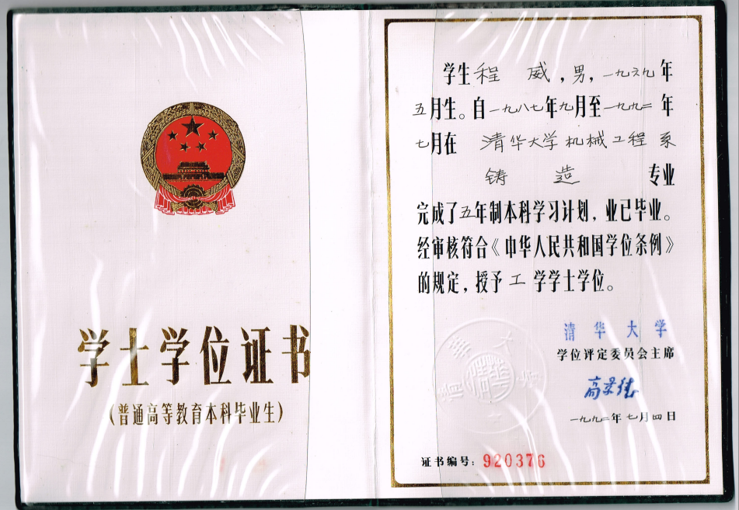
Institutional Verification System Example 1 – Tsinghua University (cont’d)

Slide 9

Institutional Verification System Example 1 – Tsinghua University (cont’d)
Chinese Numeration System
月= Month
年 = Year

Slide 10
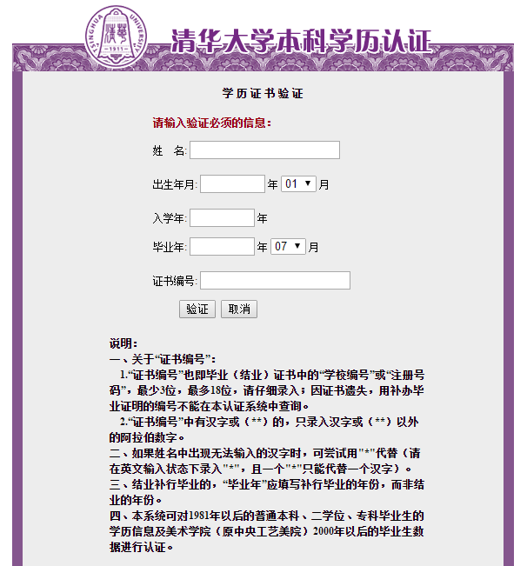
Institutional Verification System Example 1 – Tsinghua University (cont’d)
Name
Date of Birth
Enrollment Yr
Graduation Yr/Mo
Certificate Number

Slide 11
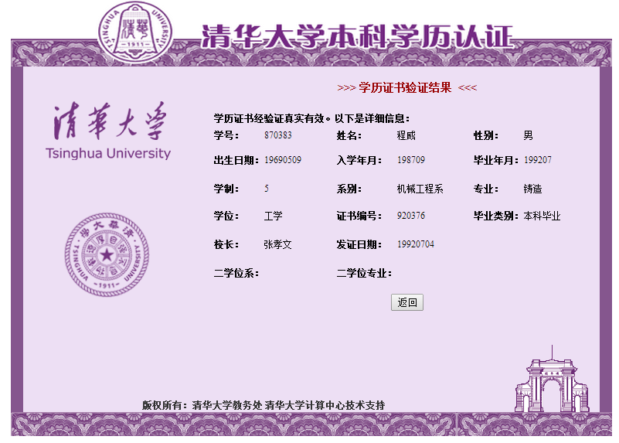
Institutional Verification System Example 1 – Tsinghua University (cont’d)

Slide 12
Institutional Verification System Example 2 – National University of Mongolia
The online verification system implemented by National University of Mongolia enables users to verify degree diplomas from 1946 to present.
Degree Diplomas issued in 2011 or after can be verified by typing in the Diploma number in the verification page
Degree Diplomas issued before the year 2011 can only be verified through the archive of graduates in the “Alumni Information” page

Slide 13
Institutional Verification System Example 2 – National University of Mongolia (cont’d)
The National University of Mongolia online verification process is relatively simple and straightforward. All you will need for performing the verification is the Diploma number, which can be located on either the degree diploma or the official transcript
National University of Mongolia Verification Page (link to the Alumni Information page is included)

Slide 14
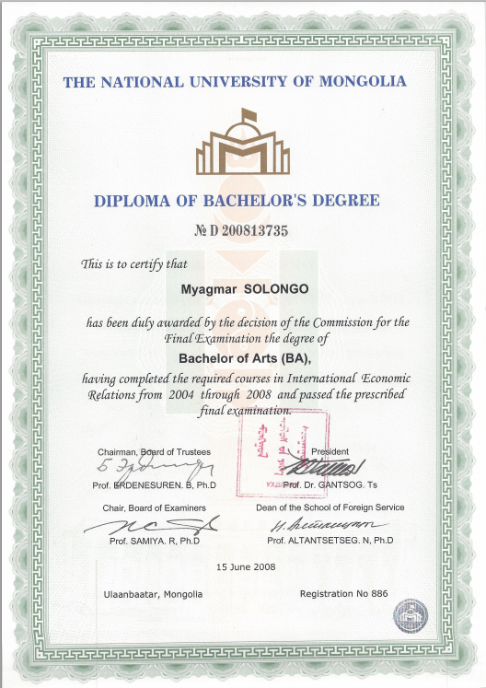
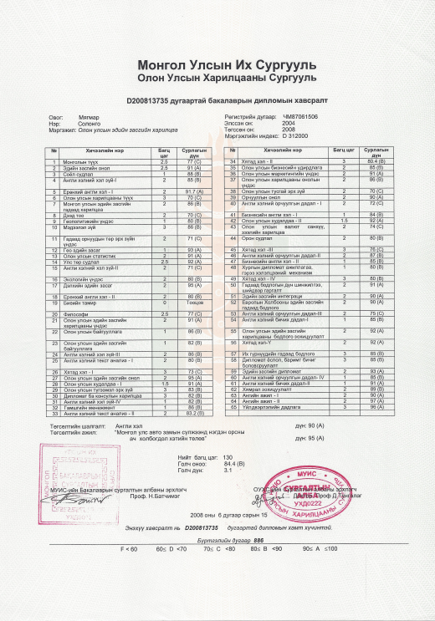
Institutional Verification System Example 2 – National University of Mongolia (cont’d)
Diploma Number
Diploma Number

Slide 15
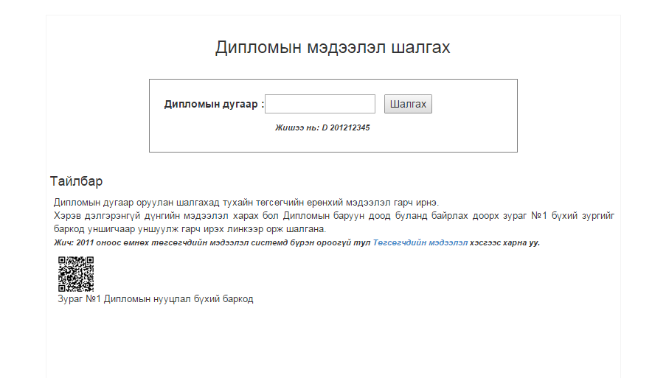
Institutional Verification System Example 2 – National University of Mongolia (cont’d)
Diploma Number
Check

Slide 16
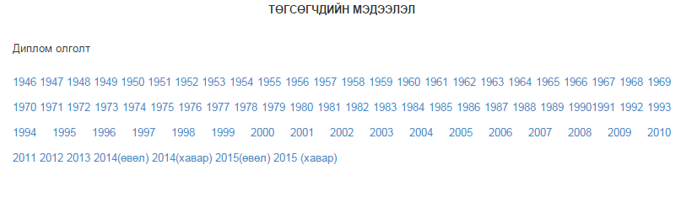
Institutional Verification System Example 2 – National University of Mongolia (cont’d)
Graduates
Issuance of Diploma

Slide 17
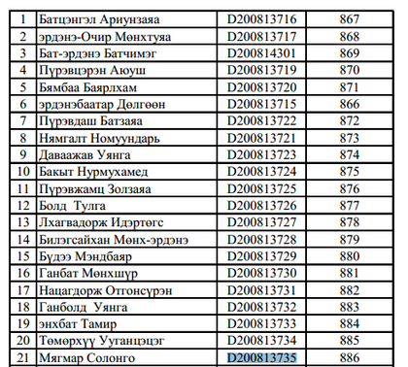
Institutional Verification System Example 2 – National University of Mongolia (cont’d)

Slide 18
Governmental
Two Types:
Verify examination results through examination bodies/boards (e.g. West African Examinations Council, National Examinations Council – NECO). Requires scratch cards with valid PIN numbers and typing in the examination year, examination type, examination number, index number, card serial number)
Verify graduation status through national electronic verification systems implemented by national education authorities (e.g. Ukrainian national verification system, Ministerio de Educación (Ministry of Education) of Ecuador verification system)

Slide 19
Governmental Verification System Example 1 – West African Examinations Council Nigeria
The online verification system implemented by West African Examinations Council Nigeria enables users to verify the West African Senior School Certificate Examination (WASSCE) results from 1991 to present.
Secondary Education Scratch Card Results Checkers
Scratch Cards can be purchased from the West African Examinations Council or from other authorized scratch card outlets in Nigeria

Slide 20
Governmental Verification System Example 1 – West African Examinations Council Nigeria (cont’d)
The cost of one scratch card = 450 Nigerian Naira, roughly $2.50 in US Dollars
Each scratch card can be used to access results up to 5 times
More detailed information about the scratch card from WAEC Nigeria: http://www.waecdirect.org/faq.htm
List of authorized scratch card outlets in Nigeria: http://www.waecdirect.org/megadealers.htm
WAEC Nigeria Verification Page

Slide 21
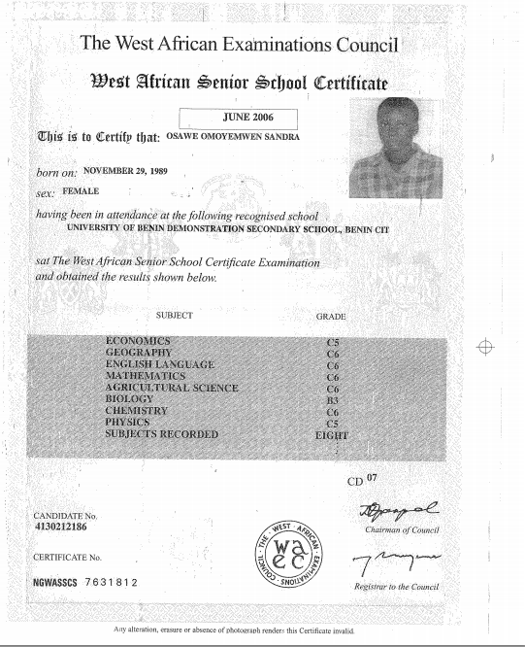
Governmental Verification System Example 1 – West African Examinations Council Nigeria (cont’d)

Slide 22
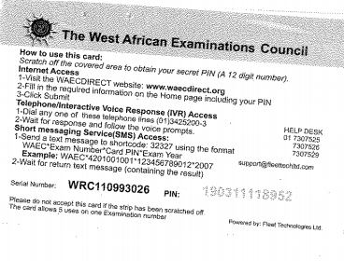
Governmental Verification System Example 1 – West African Examinations Council Nigeria (cont’d)

Slide 23
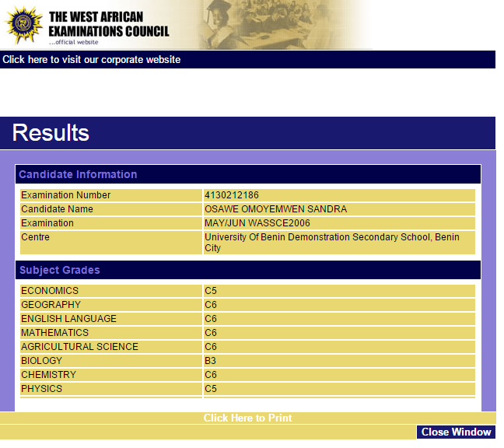
Governmental Verification System Example 1 – West African Examinations Council Nigeria (cont’d)

Slide 24
Governmental Verification System Example 2A – Ministerio de Educación, Ecuador
The online verification system implemented by Ministerio de Educación (Ministry of Education), Ecuador enables users to verify secondary school results from 1985 to present. What you will need for performing the verification:
The last name of the student or the identification number, which is printed on the Titulo de Bachiller (Title of Baccalaureate) certificate. Note that the identification number may not always be printed on the certificate.
Ministerio de Educación, Ecuador Verification page

Slide 25
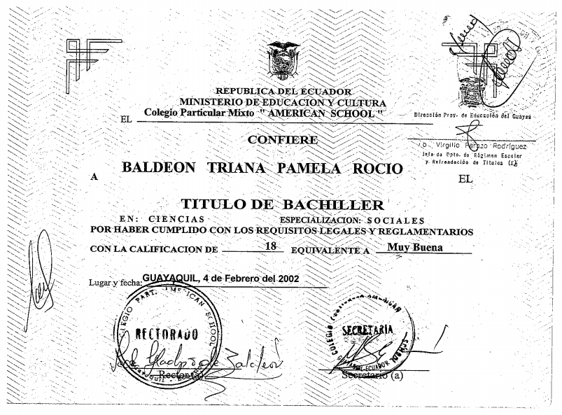
Governmental Verification System Example 2A – Ministerio de Educación, Ecuador (cont’d)

Slide 26
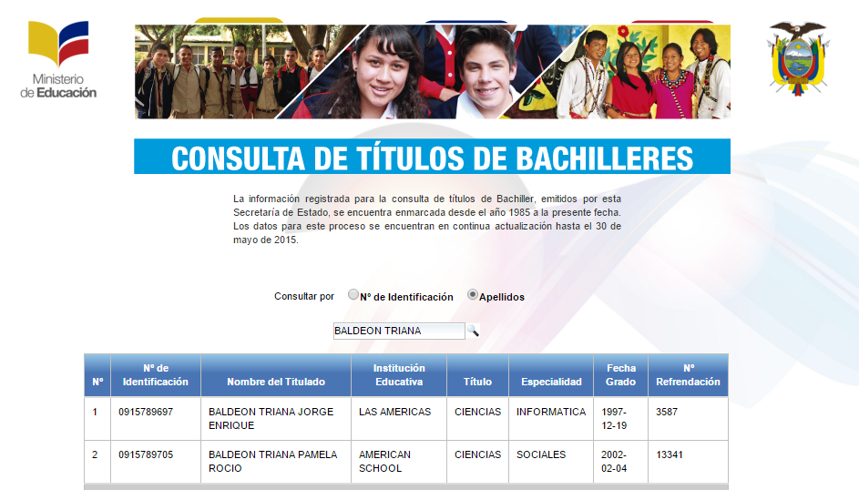
Governmental Verification System Example 2A – Ministerio de Educación, Ecuador (cont’d)

Slide 27
Governmental Verification System Example 2B – Secretaría de Educación Superior, Ciencia, Tecnología e Innovación, Ecuador
National online verification system for post-secondary credentials is also available for Ecuador. The Secretaría de Educación Superior, Ciencia, Tecnología e Innovación, Ecuador (Ministry of Higher Education, Science, Technology and Innovation) offers the verification service.

Slide 28
Governmental Verification System Example 2B – Secretaría de Educación Superior, Ciencia, Tecnología e Innovación, Ecuador (cont’d)
Last name/identification number of the student is needed for the verification, which can be found on the Titulo (Title) certificate. The identification number can be located on the back of the Titulo certificate.
Secretaría de Educación Superior, Ciencia, Tecnología e Innovación, Ecuador Verification page

Slide 29
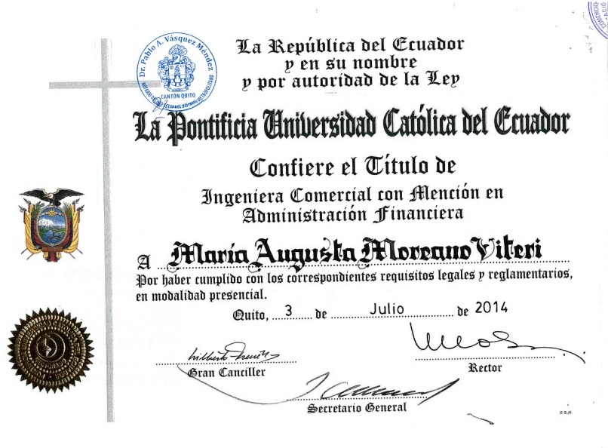
Governmental Verification System Example 2B – Secretaría de Educación Superior, Ciencia, Tecnología e Innovación, Ecuador (cont’d)

Slide 30
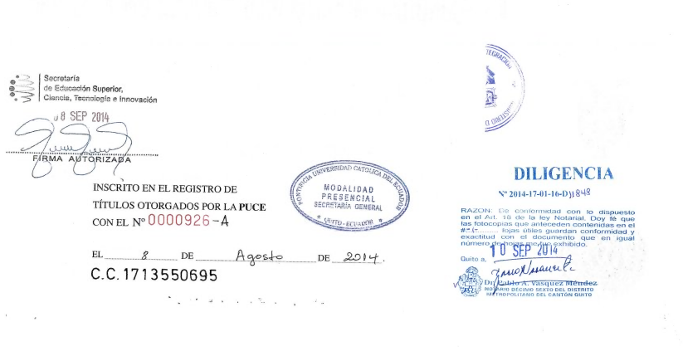
Governmental Verification System Example 2B – Secretaría de Educación Superior, Ciencia, Tecnología e Innovación, Ecuador (cont’d)
Identification No

Slide 31
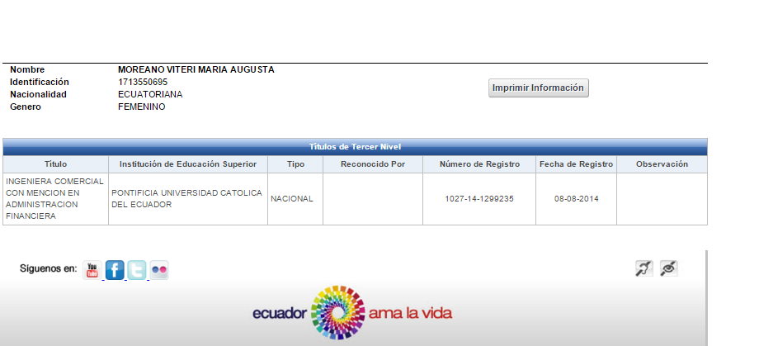
Governmental Verification System Example 2B – Secretaría de Educación Superior, Ciencia, Tecnología e Innovación, Ecuador (cont’d)

Slide 32
Special Example – University of Baghdad
Online verification is not always a smooth process, sometimes a little number rounding and a creative interpretation are needed!
Example from University of Baghdad:
Student was ranked 13 out of 124 graduates in the Department of Public Administration, College of Administration and Economics Registration. Student’s final average was 76.94, as indicated on the graduation certificate/transcript

Slide 33
Special Example – University of Baghdad (cont’d)
The list of graduates from the alumni database indicates that the student who was ranked 13 in the department has a final average of 76.937, and not 76.94 as indicated on the submitted document – What should you do in this case?
Suggestion: Verify the student’s name in Arabic and match it against the list of graduates. Round the final average from three to two decimal points
University of Baghdad Verification page

Slide 34
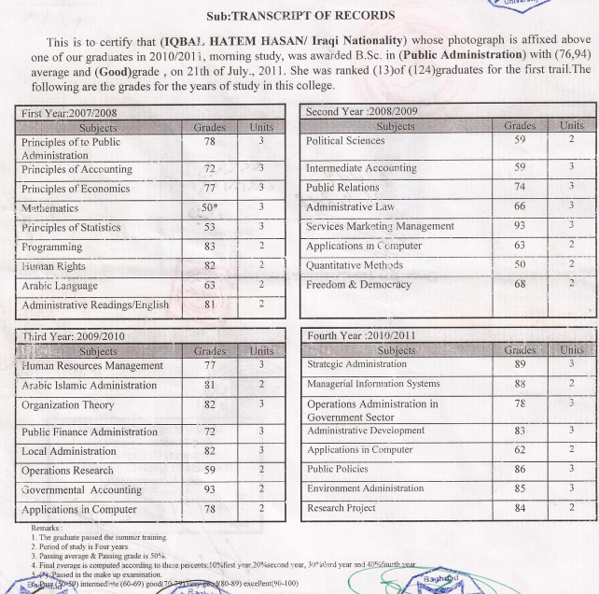
Special Example – University of Baghdad (cont’d)

Slide 35
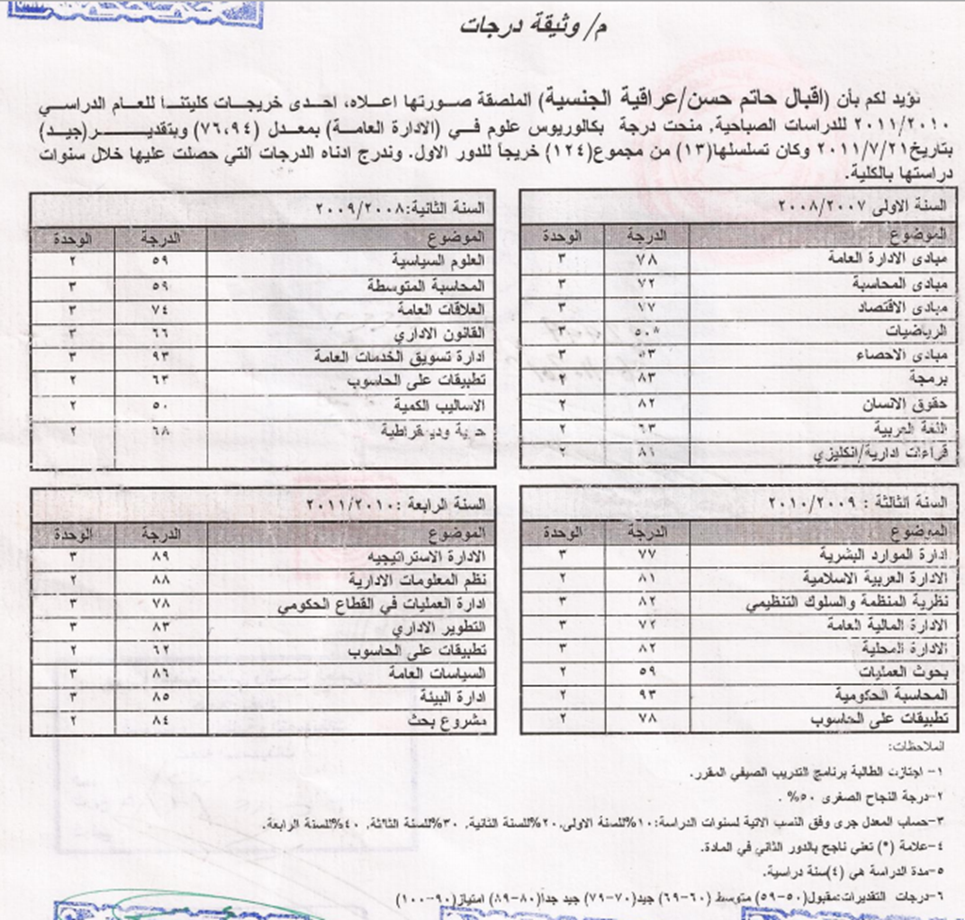

Slide 36
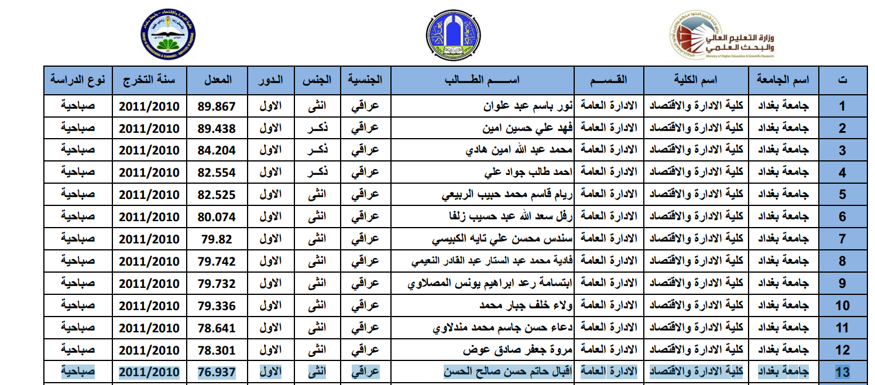

Slide 37
Why use electronic verification in International Admissions?
Admit based on unofficial docs uploaded by students, then require officials upon arrival (hold is placed on 2nd semester enrollment)
  Verifying documents would eliminate the need to request additional official documents
Currently we only verify a few kinds of docs on a regular basis (WAEC, for example), and suspicious-looking documents

Slide 38
Should we implement a new policy/practice?
Pros
Cons
Admission process is easier for students
Less holds/verification of hard copies after admission
More likely to catch fraudulent documents
More practical for us then other kinds of verification
Limited availability of electronic verification-can’t verify all docs
Need to train staff on new business practice
“Fragility” of some of the verification resources

Slide 39
Revising our Business Practices
At which step in the process will we insert this new procedure?
Who will do the electronic verification?
How will we document the results of the verification?

Slide 40
Implementation
Write/revise policies and procedure documents
Create resources for staff to use (consider organization: by country? Secondary vs. post-secondary?—and medium: paper vs electronic format)
Train staff on new policies/procedures/resources

Slide 41
Now what?
Is this new process working?
--collect data (number of docs successfully verified, number of fraudulent docs, feedback from staff, etc)
Revise based on data collected
Resource document—needs to be updated frequently. Who updates this?

Slide 42
Questions?
Thank you so much for attending our session!

Slide 43
Contact Information
Quentin Law Phu
Foreign Credits, Inc.
2800 S River Road, Suite 460
Des Plaines, IL 60018
qphu@foreigncredits.com
(224) 521-0170
Kelly Sumner
IUPUI Office of International Affairs
ES 2126
902 W. New York St.
Indianapolis, IN 46202
kelketho@iupui.edu
(317) 274-0108

