Slide 1
The French Grading System: Credential Evaluation, Interpretation of Islamic Culture and the Lack of Perfection
NAFSA Region V Conference, Grand Rapids, MI 2014
Quentin Law Phu
Othman Zaimi
Foreign Credits, Inc.
University of Wisconsin at River Falls

Slide 2
Overview of Presentation
Introductions
Warm-up Quiz
History of the French Grading System
Lack of “Perfection” in Islamic and French cultures
Evaluating French-based credentials
Evaluation Practice in Small Groups
Resources
Q & A Session

Slide 3
Pop Quiz Time! Surprise?

Slide 4
Do you know what is the top grade in the French grading system?
20/20! Yes you got it!

Slide 5
Warm-up Quiz
Countries using the French Grading System:
Sporcle Quiz

Slide 6
History of the French Grading System
How is the French grading system structured and how has it evolved historically?

Slide 7
French Grading System: Past & Present
Oliver Maulini (1996)
16th century Jesuit Schools

Slide 8
French Grading System: Past & Present
Extract from 1780 Report Card for student in the Royal College of Cahors:
Values and Religion: Excellent
Character: Excellent, too timid
Placement out of the 53 students (November/December)
Theme: 27th/39th
Version: 13th/30th
Verses: 44th/26th
Maulini (1996) [translated from French]

Slide 9
French Grading System: Past & Present
1=Bien (Good)
2= Assez Bien (Somewhat Good)
3= Médiocre (Mediocre)
4= Mal (Bad)
Maulini (1996) [translated from French]

Slide 10
French Grading System: Past & Present
1882 Schools in Geneva – Good Grades Coupons
Coupons will be calculated in the end for prizes
Knives and whistles for boys
Scissors and hairbrushes for girls
1850, France adopted the 20/20 scale officially

Slide 11
Lack of “Perfection” in Islamic and French Cultures

Slide 12
19 out of 20 - Numberphile

Slide 13
“Grade 20 is for God, 19 is for the Professor, 18 is for the Pope and 17 is the maximum grade that the student will attain” – Paul Simon

Slide 14
Lack of Perfection – A cultural phenomenon
It is extremely rare for a student to receive a grade of 20 under the French grading system!

Slide 15
Lack of Perfection – A cultural phenomenon
Michel Criton (2008)
1968 Minister of Education “Edgar Faure”
Instructors added “+” and “-” to their grades
The grades became:
A++, A+, A, A-, A--…….E-, E--

Slide 16
How Islamic culture affects grades
A personal experience in Morocco

Slide 17
Ozzy’s Personal Experience
Many teachers in Morocco have told him:
“20/20 is for god only, nobody is perfect but Allah”

Slide 18
Evaluating French-based credentials

Slide 19
French-Based Grading Basics I
French-based grades are awarded on a scale of 1-20
Traditionally, grades higher than 16 are seldom awarded
It is extremely rare for a student to receive a grade of 20

Slide 20
French-Based Grading Basics II
The passing grade for a single subject is usually 10/20
Grades of 8 and 9 are considered passable as long as the overall (combined weighted) average of grades remains at or above 10 in an academic year. Also referred to as “conceded passes”
A student is considered to have passed the year when the combined weighted average of all grades for that year comes to at least 10

Slide 21
How to perform basic grade conversion on French-based credentials?

Slide 22
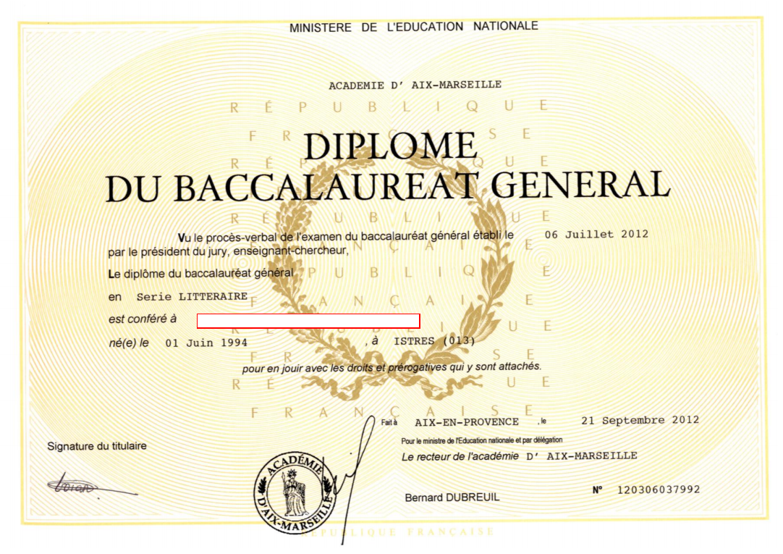

Slide 23
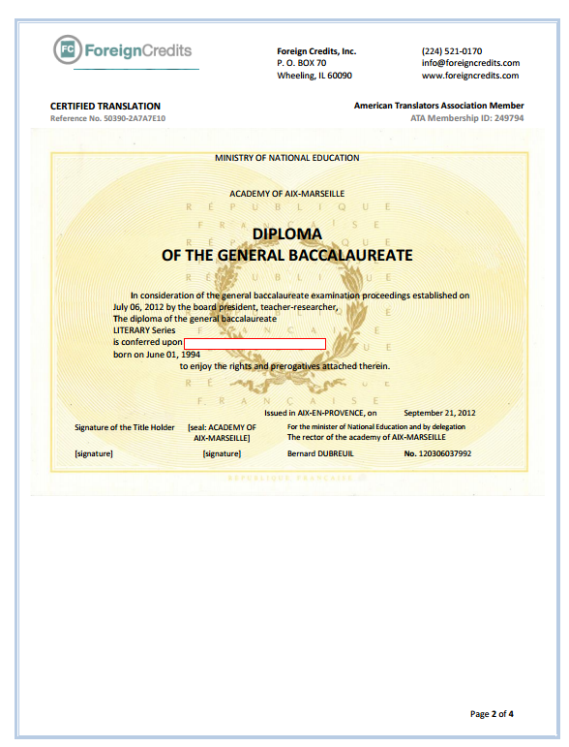

Slide 24
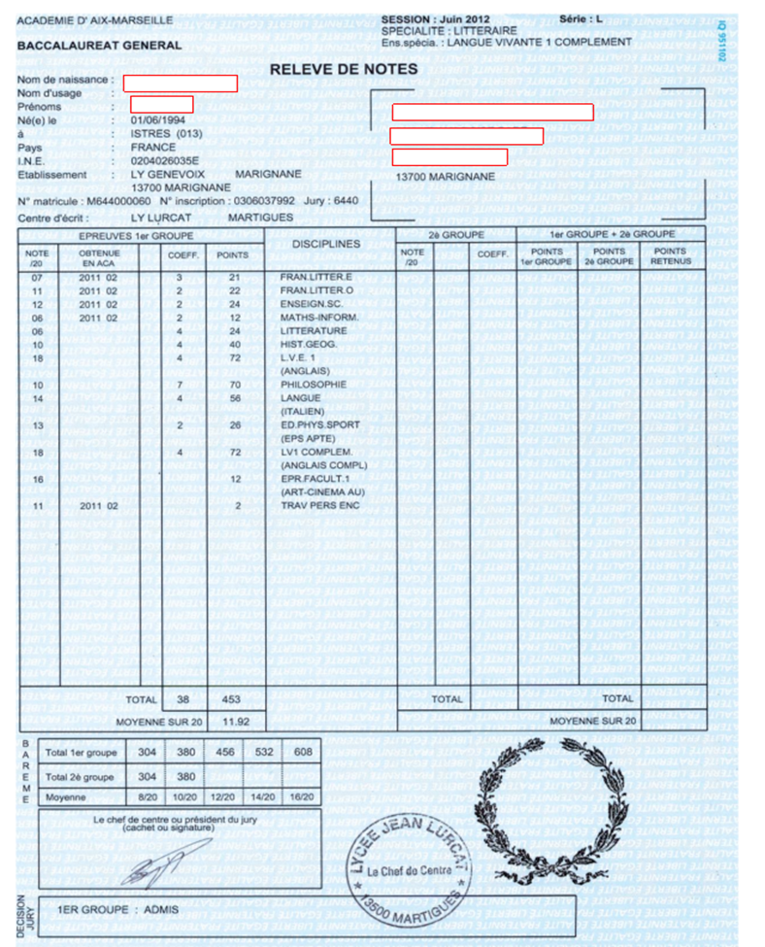

Slide 27
Basic Grade Conversion

Slide 28
Calculating the GPA
Evaluate your transcript, and convert into the appropriate credits, and US grades
Multiply the credits for each course by the grade points value of the US grade
Add the credits together and determine the total
Add the grade points together and determine the total
Divide the total number of grade points by the total number of credits to get the GPA
GPA = Total Grade Points / Total Credits

Slide 29
Electronic GPA Calculator
This international GPA calculator is intended to help you calculate the United States Grade Point Average (GPA) based on grades or points from almost any country in the world.
Foreign Credits' GPA calculator analyses about 300 grading scales from over 150 countries and calculates an unweighted GPA on a 4.0 point scale.

Slide 30
Calculating the Credits: Strategy I
Identify the total number of foreign subjects completed in the program.
Identify the number of full-time years completed in the program.
Determine the number of U.S. credits that would be completed in the same time period
Calculate the conversion factor (U.S. credits in a similar timeframe/total foreign subjects)
Multiply by the conversion factor to determine the U.S. credits
Conversion Factor =
(multiplier)
# credits I expect
# subjects I have

Slide 31
French Coefficients I
French, or Francophone coefficients also indicate the weight of a course.
When determining the credit values of French or Francophone coefficients, you will generally see the weight of a course identified in one of two ways:
A single-digit coefficient (that looks very similar to a credit hour on a U.S. transcript)
A multiple of 20, the highest number of marks on the grading scale

Slide 32
French Coefficients II
Relative weight of a subject = Determined by its coefficient
The higher the value of the coefficient = the greater the importance of the subject
Courses with higher coefficients= need a larger percentage of the targeted credits hours
Certain transcripts may not have the coefficients listed in a separate column. The subjects may have a grade based on a larger or smaller grading scale that go from 0-20, 0-40, 0-60, 0-80, and so on. The coefficient will be the multiple of 20 in these cases

Slide 33
Calculating the Credits: Strategy II
Determine the total number of foreign credits completed in the program
Identify the number of full-time years completed in the program
Determine the number of U.S. credits that would be completed in the same time period
Calculate the conversion factor (total foreign credits/ U.S. credits in a similar timeframe
Divide by the conversion factor to determine the U.S. credits
Conversion Factor =
(divisor)
# credits I have
# credits I expect

Slide 34
Credential Evaluation Practice
Now that you have learned how to perform basic grade conversion with French-based credential, let’s put your knowledge into practice!

Slide 35
Case Scenario
Student A has passed the Baccalauréat de l'Enseignement Secondaire (Baccalaureate of Secondary Education) examination in Tunisia and was awarded a High School Diploma and given access to university/post-secondary studies locally and abroad. The student is applying for undergraduate admission to your university as an international student.

Slide 36
Admission Decision
If you are the international admission officer, would you accept this student from Tunisia for admission to an undergraduate degree program at your university based on his grades and GPA? Please tell us your admission decision.

Slide 37
Sample Credential for Practice
Please convert the grades listed on the sample transcript to the US grade equivalencies based on the Tunisia French-based grading scale.

Slide 38
Basic and Free Electronic Resources

Slide 39
Resources can be used for:
Placement Recommendations
Institutional Accreditation and Verification
Program Information
Grading Scales
Country Information and Research

Slide 40
http://www.nafsa.org/Resource_Library_Assets/Publications_Library/Online_Guide_to_Educational_Systems_Around_the_World/

Slide 41
Great for information like standard program length and degree/certificate names
http://www.nafsa.org/_/File/_/ges/France.pdf

Slide 42
http://www.nuffic.nl/en/diploma-recognition/country-modules/country-modules

Slide 43
http://www.nuffic.nl/en/library/country-module-france.pdf

Slide 44
http://www.playnaia.org/page/intldirectory.php

Slide 45
http://www.playnaia.org/d/international/NAIAEC_IntlDirectory_France.pdf

Slide 46
Other Free, Electronic Resources
Classbase:
http://www.classbase.com/
Alberta International Education Guides:
http://work.alberta.ca/Immigration/international-education-guides.html
NORRIC Publications:
http://norric.org/publications/publications#countries
WES Country Profiles:
http://www.wes.org/wes_tools/profile.asp

Slide 47
Questions?

Slide 48
Contact
Quentin Lawphu qphu@foreigncredits.com Othman Zaimi othman.zaimi@uwrf.edu

