Slide 1
Sharing Strategies for Establishing Yourself in IE Before Earning a Master’s Degree
Sonya Brauchle, International Education Specialist at Foreign Credits, Inc.
Mallory Ericson, Manager of Marketing and Program Advisement at
World Endeavors
Ashley Metz, Executive Assistant in the Learning Abroad Center at the University of Minnesota

Slide 2
AGENDA
Introductions
Breaking Into the Field:
Experience Abroad, Language Experience, Local Multicultural Experience, Internships, Undergraduate, Informational Interviews, Non-Field Related Experience, Higher Education, Job Boards and Resources
Establishing yourself in the field:
Scholarship, Online Presence, Field Knowledge and Resources, NAFSA, Mentoring
Going forward:
Resumes, Networking, Discussion

Slide 3
INTRODUCTIONS
What was your first job in the field OR what type of job are you interested in?
What do you hope to learn today?

Slide 4
EXPERIENCE ABROAD
Opportunities abroad:
Teaching and Advising
Interning
Volunteer Work
Peace Corps
Study Abroad
Notes:
SONYA
My own experience: China (teaching), Spain (learning), travelling around
Why important? Catalyst to almost everyone entering the field. How do you apply it to your job
Interacting with students
Advising
Working when the students aren't actually there.
What skills do you bring back to your job? Language, interaction, communication, first hand experience - my perspective as a credential evaluator, what I learned about what each country values in their education, very clearly affects everything about the culture.

Slide 5
EXPERIENCE ABROAD
Why is this important?
How does it affect your job day to day?
How about your job search?
Professional Development
What actual ‘skills’ do you bring back to your job?
Communication and Problem Solving
Language Experience
Notes:
Almost every international education job asks for international experience/experience abroad
how do you talk about your experience, what strengths does it build?
not just before your job - short term programs, internships, etc. - be creative - convince your job to support you!
multi cultural sensitivity

Slide 6
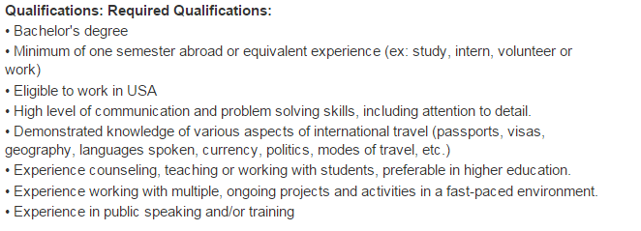
EXPERIENCE ABROAD:
Applying Experience
Study Abroad Advisor
Bachelor’s degree
Minimum of one semester abroad or equivalent experience (ex. study, intern, volunteer or work)
High level of communication and problem solving skills, including attention to detail
Experience counseling, teaching or working with students, preference in higher education
http://jobregistry.nafsa.org/jobs/7622796/study-abroad-advisor

Slide 7
LANGUAGE
Why is this important?
How does this assist you in your job?
Communication
Point of view
My experience
Studying language
In hiring advisors

Slide 8
LANGUAGE
Undergrad Experience
Major/Minor
Study Abroad
After Graduation
International experience
Immersive Programs
Teaching Abroad
Within your home community

Slide 9
LOCAL INTERCULTURAL EXPERIENCE
International student exchange programs
American Field Services (AFS)
Volunteer as liaison
Host a student
Help at events, retreats, or chapter meetings
Art
Culture festivals
Museums

Slide 10
LOCAL INTERCULTURAL EXPERIENCE
Language learning
Local college or university classes
Language partner (through school or organization)
Community education classes
Food
Restaurants
Cooking classes through community education
International grocery stores

Slide 11
INTERNSHIPS
Undergrad
Study Abroad Office
International Student Services
Multicultural Office
After Graduation
Global Companies/Non-Profit Organizations
Provider Companies
Personal Experience

Slide 13
INFORMATIONAL INTERVIEWING
How do you find professionals to “interview”?
Difference between an informational and a job interview.
Benefits - long and short term.
Notes:
learn about what you like and don’t like
find people that do what you want to do learn habits, get advice, learn how they got there
environments you like - small vs. large
do this even while you’re at your current job

Slide 14
UNDERGRADUATE CAMPUS HELP
Volunteering in study abroad offices
Volunteering in international student services offices
Helping at study abroad fairs
Give classroom presentations about your experiences abroad
Peer mentoring through international student services office programs

Slide 15
NON-FIELD RELATED EXPERIENCE
Customer Service
People skills
Patience
Media/Communication
Online research
Familiarity with various programs (ex: Microsoft Office, Adobe)
Budgeting/Finance

Slide 16
NON-FIELD RELATED EXPERIENCE
Event Planning
Web Design and Maintenance
Grant Writing
Blogging
Photojournalism
Social Media
Career Services/Advisement

Slide 17
EXPERIENCE IN HIGHER EDUCATION
Knowing departments and offices on campus
Connections with people on campus
Understanding the climate and organization
Understanding values and goals of the institution
Easier to move within the system then get in from the outside
Experience working with students
Experience with or knowledge of management systems (example: PeopleSoft, Banner)

Slide 18
SCHOLARSHIPS/FINANCIAL HELP
Have basic knowledge of financial aid and the Federal Pell Grant (and how they affect students paying to participate in your programs)
Be aware of scholarships available at your current institution/organization/company (or where you hope to work)
Review scholarship applications if/when possible (institutions, organizations, community groups)

Slide 19
SCHOLARSHIPS/FINANCIAL HELP
Encourage others in your office, organization, or campus to also review applications
Serve on panel for Benjamin A. Gilman International Scholarship Program
Learn about Boren, Fulbright, and other national scholarship opportunities

Slide 20
BUILDING AN ONLINE PRESENCE
The usual: LinkedIn, Facebook
Everything you do professionally - make sure it’s documented and searchable!
Message Boards, Forums, Listserv
Blogs and Articles
Virtual Networking Groups
Notes:
SONYA - put your presentations online! this will be on www.foreigncredits.com

Slide 21
BUILDING AN ONLINE PRESENCE;
Message Boards and Forums
NAFSA Connections
Message Board and Forums
Collegial Conversations
Member Interest Groups
Other Forums and Connections

Slide 22
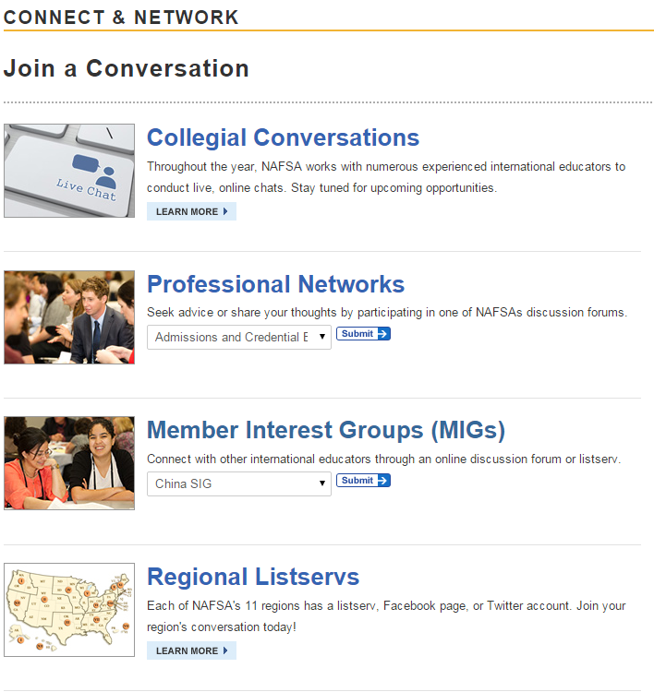
BUILDING AN ONLINE PRESENCE:
Connect with NAFSA

Slide 23
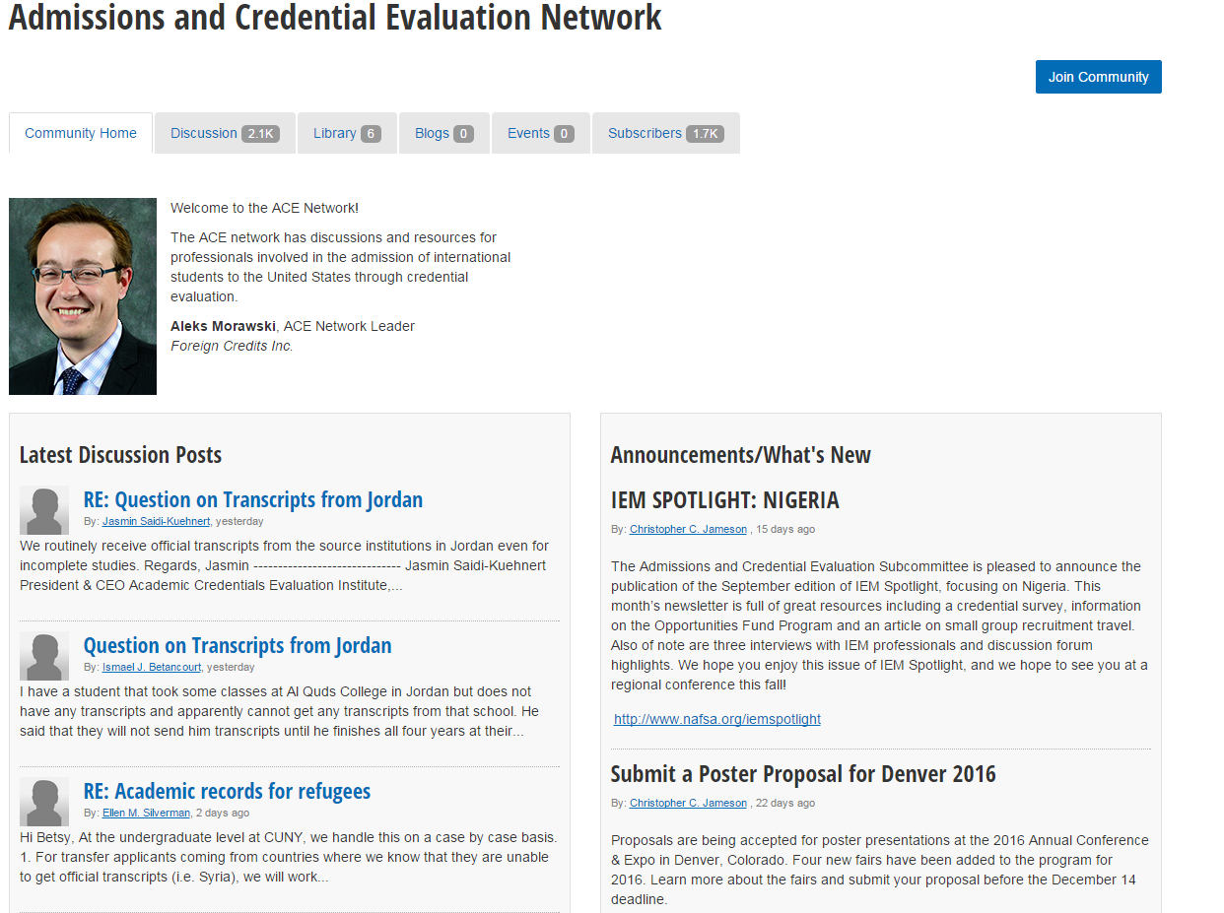
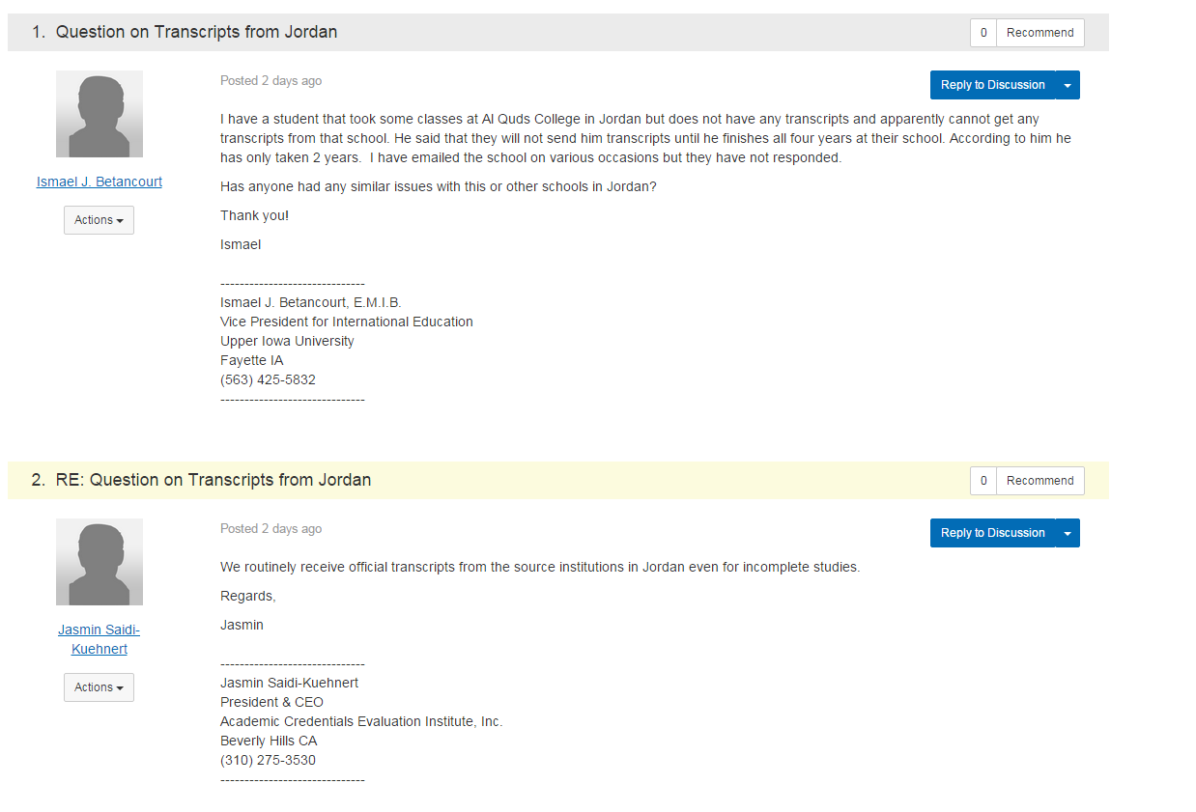
BUILDING AN ONLINE PRESENCE
Message Boards and Forums - NAFSA
http://network.nafsa.org/communities/community-home?communitykey=e99f8907-0c5d-43ee-a654-824ca5cb923c
Notes:
ACE network - you can ask anything

Slide 24
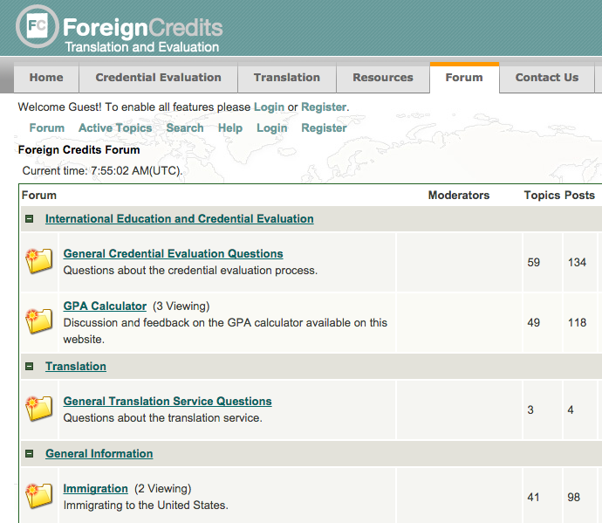
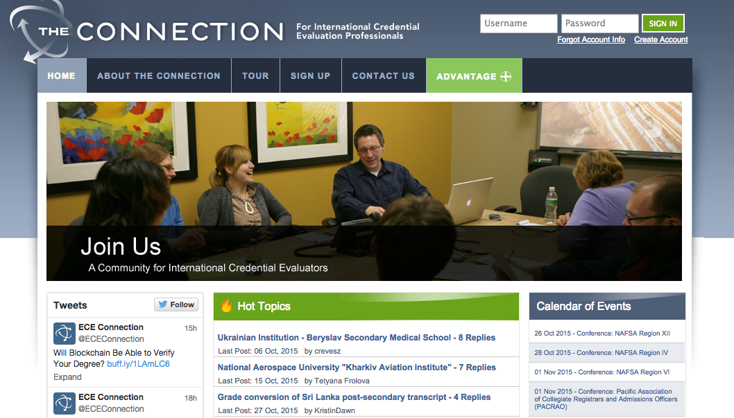
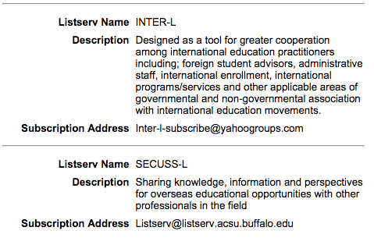
BUILDING AN ONLINE PRESENCE:
Message Boards and Forums
www.foreigncredits.com/forum
theconnection.ece.org
Notes:
free!!

Slide 25
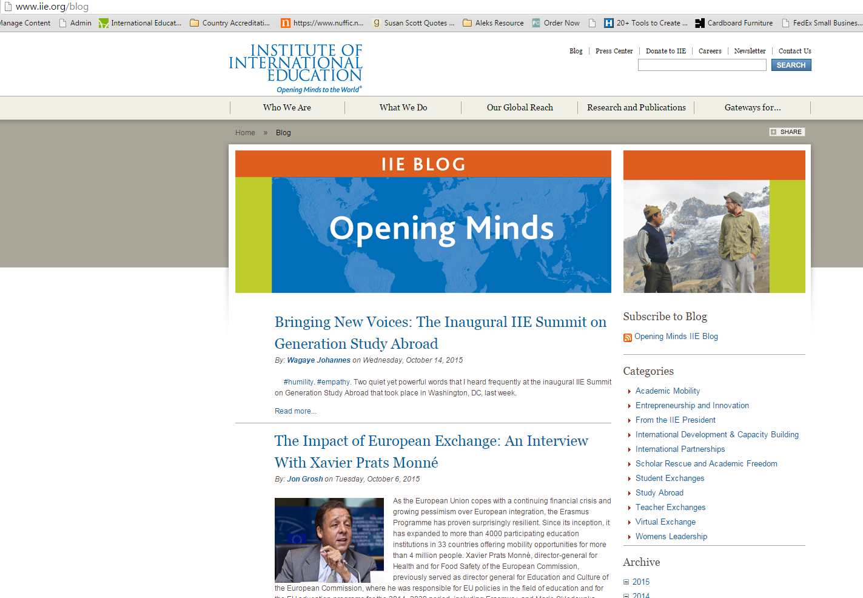
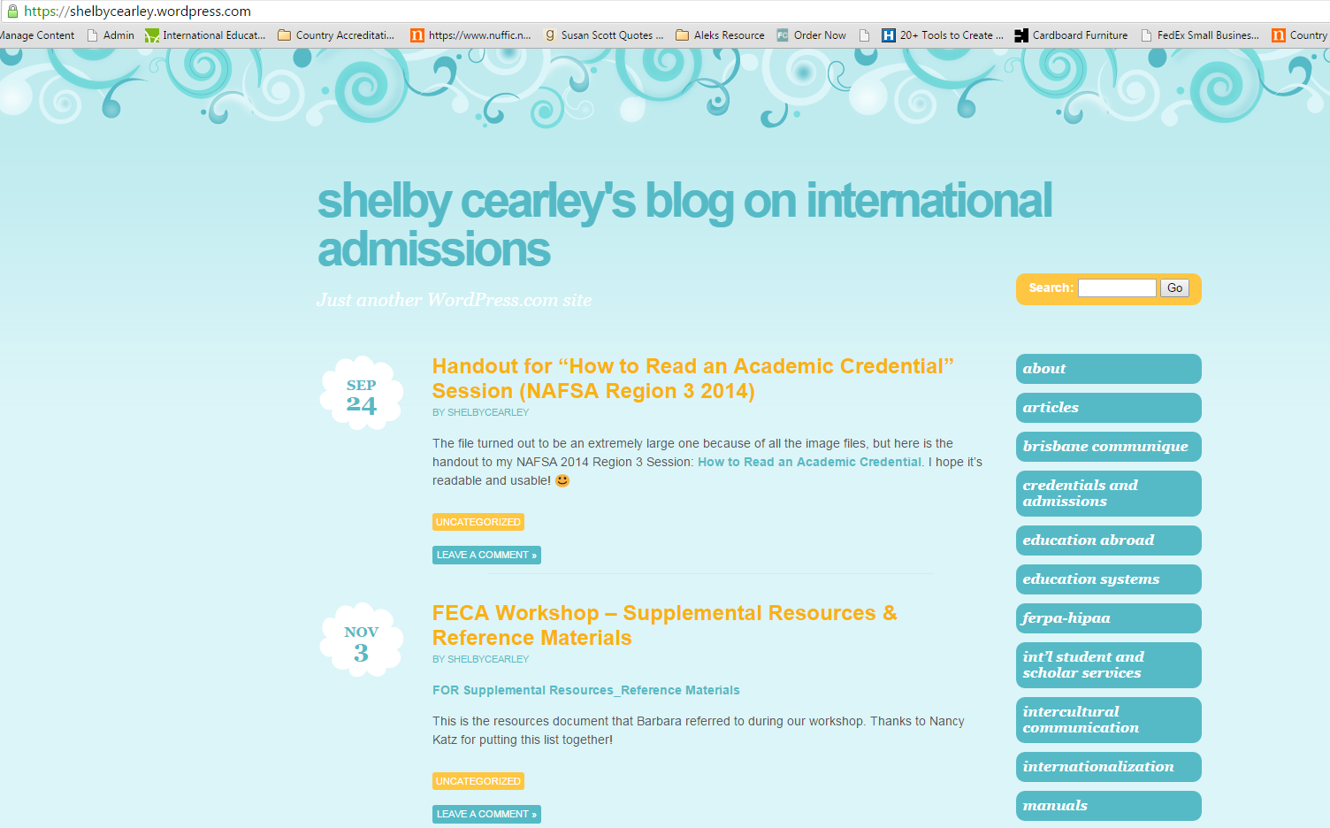
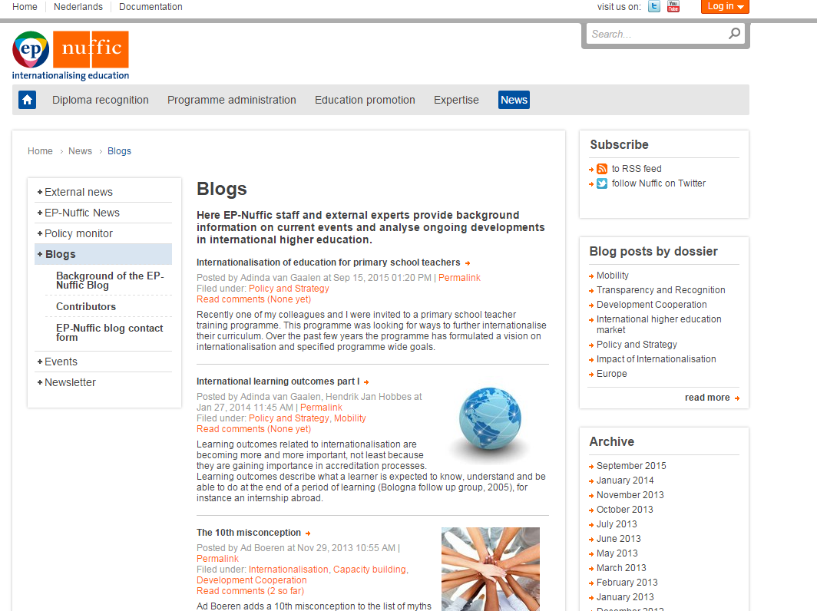
BUILDING AN ONLINE PRESENCE:
Blogs
https://www.nuffic.nl/en/news/blogs
http://www.iie.org/blog
https://shelbycearley.wordpress.com/2015/09/24/handout-for-how-to-read-an-academic-credential-session-nafsa-region-3-2014/

Slide 26
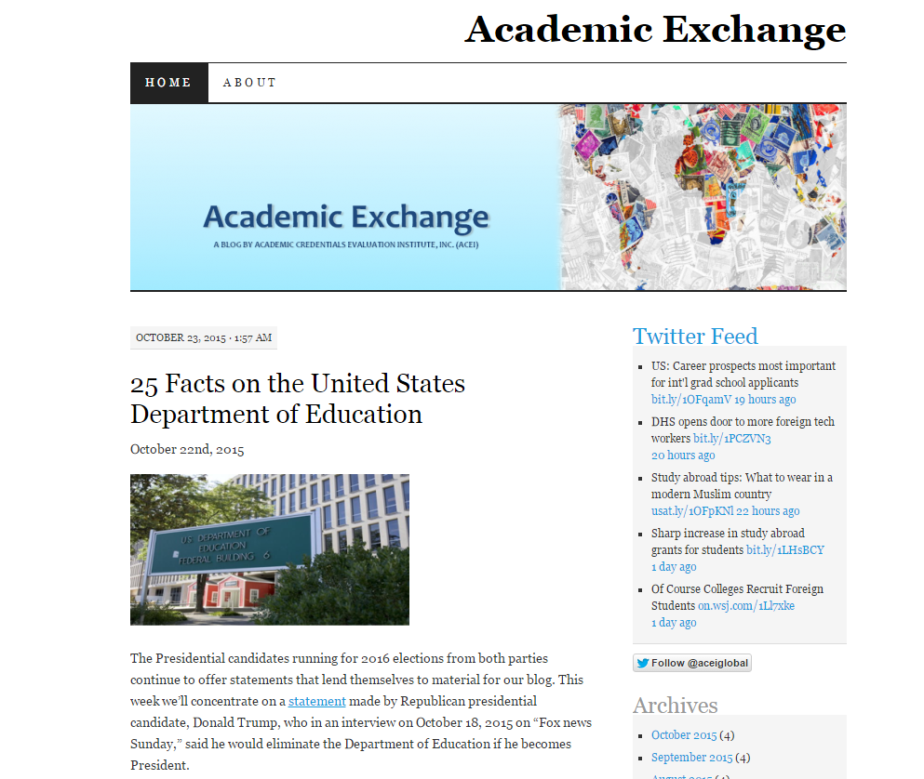
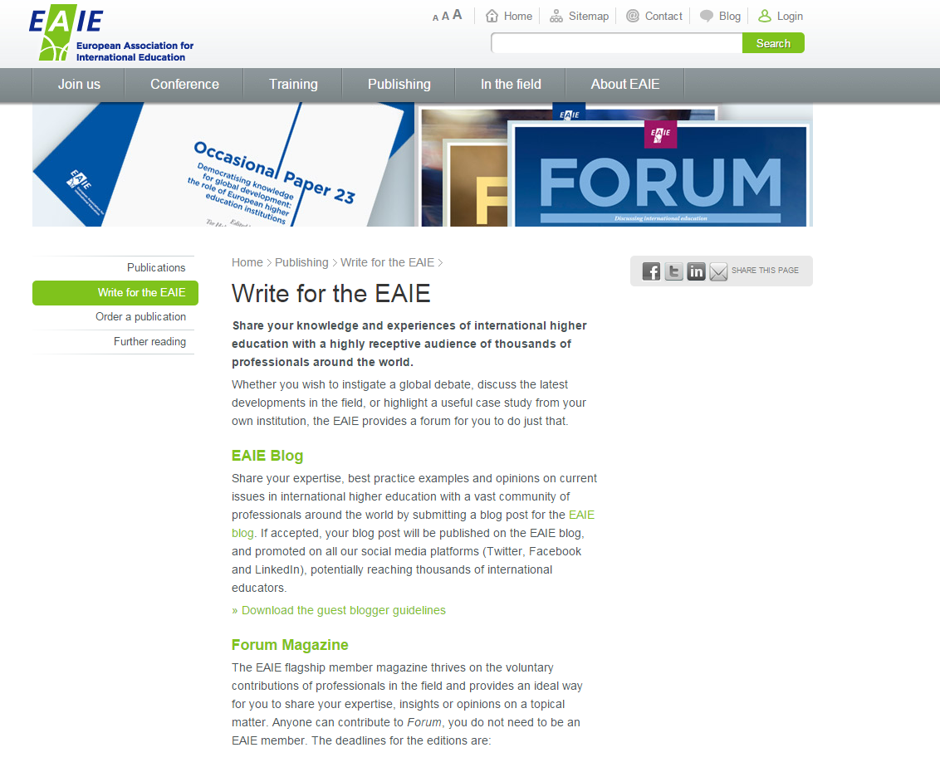
BUILDING AN ONLINE PRESENCE:
Blogs
https://academicexchange.wordpress.com/2012/03/02/from-iran-to-irangeles-a-tribute-to-iranian-americans/
http://www.eaie.org/home/publishing/write-for-the-EAIE.html
http://www.goabroad.com/blog/write-for-us/
https://www.upwork.com/o/profiles/browse/skill/blog-writing/

Slide 27
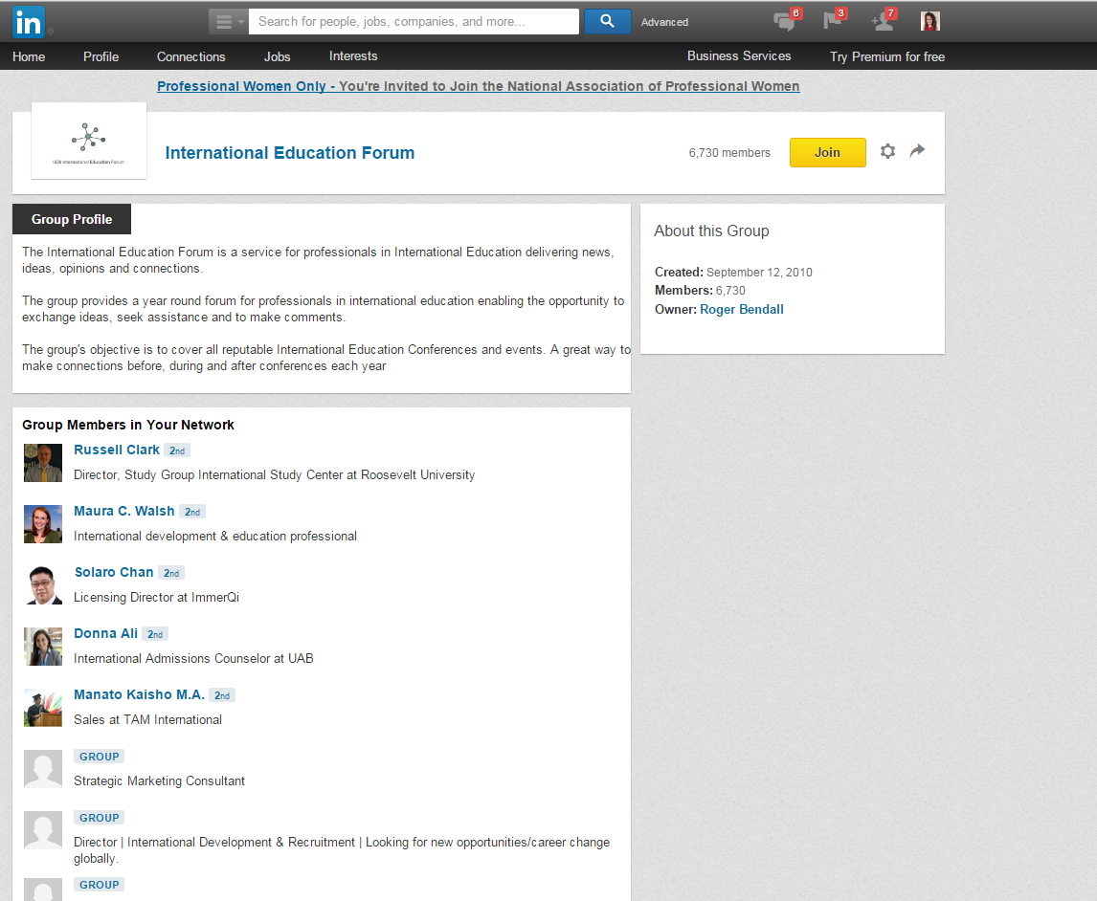
BUILDING AN ONLINE PRESENCE:
Virtual Networking Groups

Slide 28
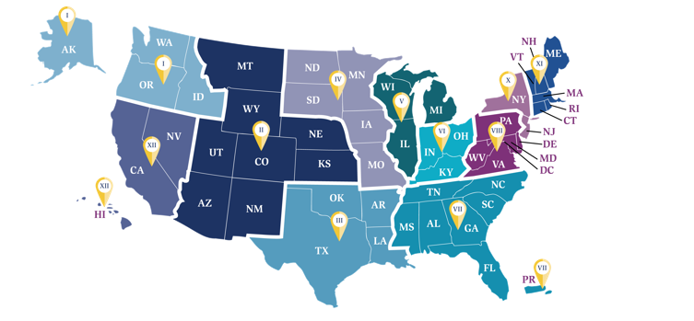
NAFSA: Getting Involved

Slide 29
NAFSA: Professional Development and Getting Involved
At Conferences:
Regional and National - Volunteering, Grant Opportunities, Present!, Poster Sessions, Leading Workshops/Trainings, Open Meetings
Networking and Professional Development:
Knowledge Communities, NAFSA Academy, Advocacy Day, Volunteer/Team Positions, Trainer Corps, Certifications
Learning Opportunities at Home:
Webinars, Attending Sessions, Resources for your desk, Collegial Conversations
Notes:
SONYA

Slide 30
NAFSA: Conference Involvement
How to get involved:
State, Regional, and National level
Funding
Volunteering
Grant Opportunities
Present!, Poster Sessions, Workshops/Trainings
Open Meetings

Slide 31
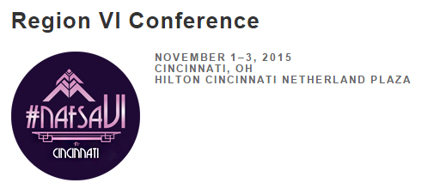

Slide 32
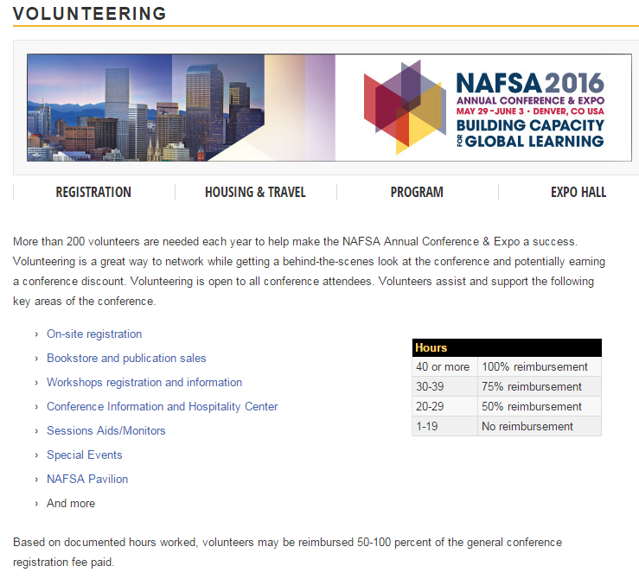
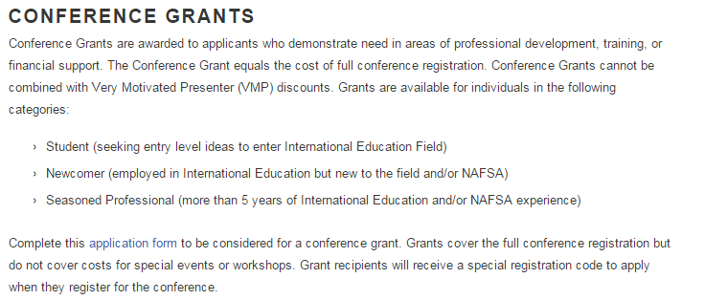
NAFSA: Conference Involvement
Volunteering and Grants
http://www.nafsa.org/Attend_Events/Annual_Conference/Registration/Volunteering/

Slide 33
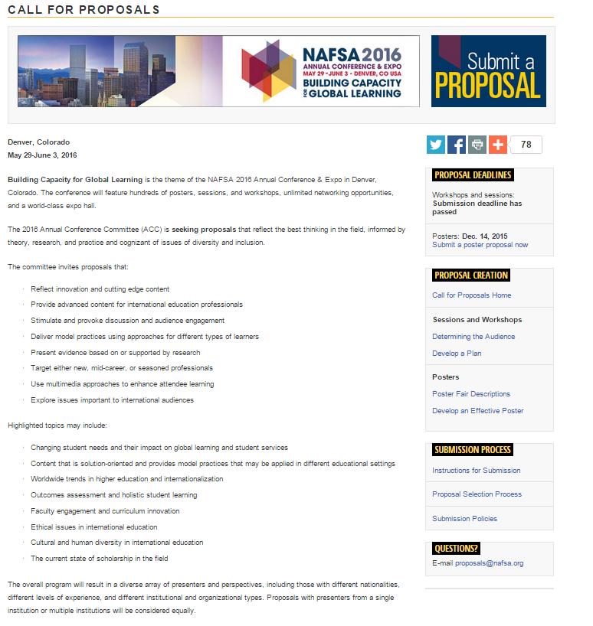
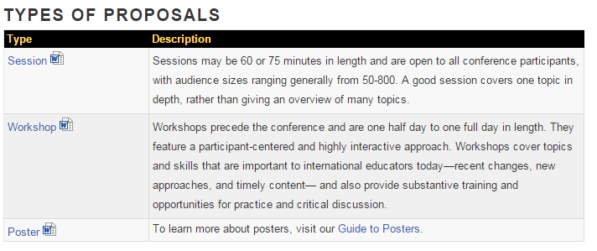
NAFSA: Conference Involvement
Presenting
Deadline for Posters: Dec. 14, 2015
http://www.nafsa.org/Attend_Events/Annual_Conference/Call_For_Proposals/

Slide 34
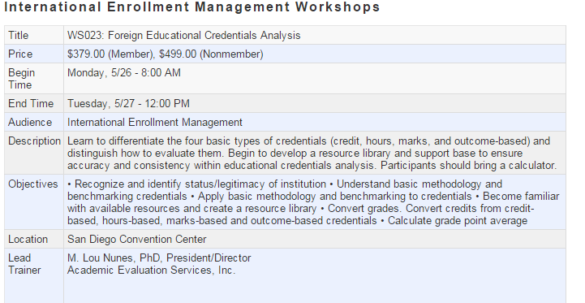
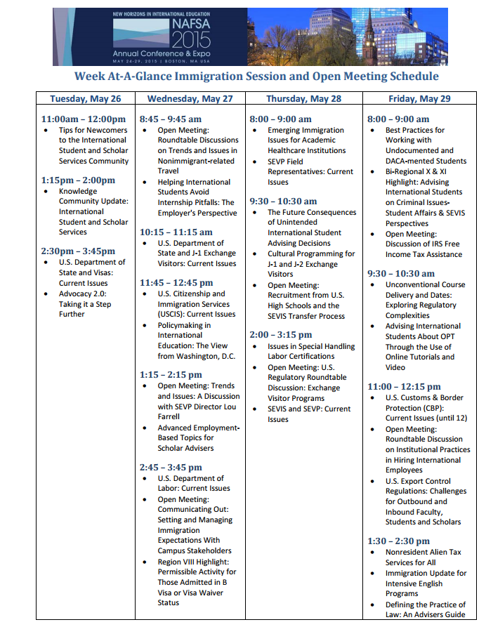
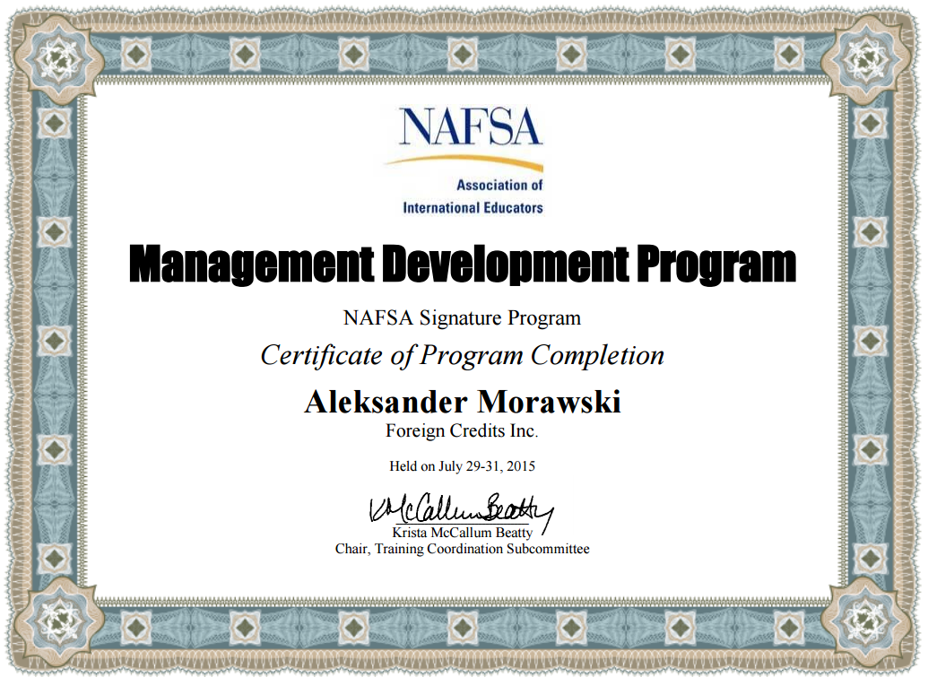
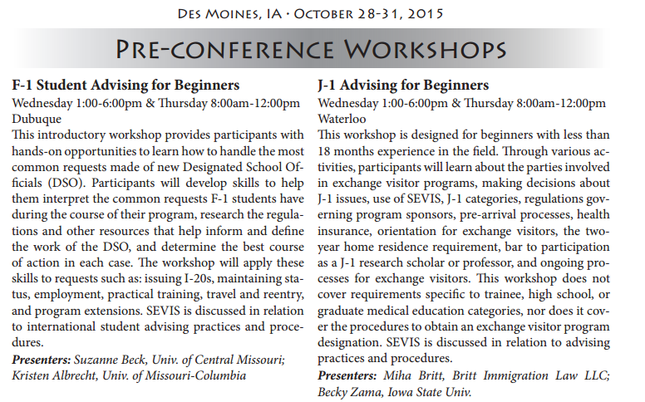
NAFSA: Conference Involvement
Workshops/Trainings, Open Meetings, Certifications
Notes:
list all certificates, etc. on resume - not just for leading; specialized

Slide 35
NAFSA: Professional Development and Networking Strategies
Knowledge Communities
Formal Training
NAFSA Academy and Trainer Corps
Advocacy - Advocacy Day
Volunteer/Team Positions
http://www.nafsa.org/Attend_Events/Annual_Conference/Networking_Opportunities/

Slide 36
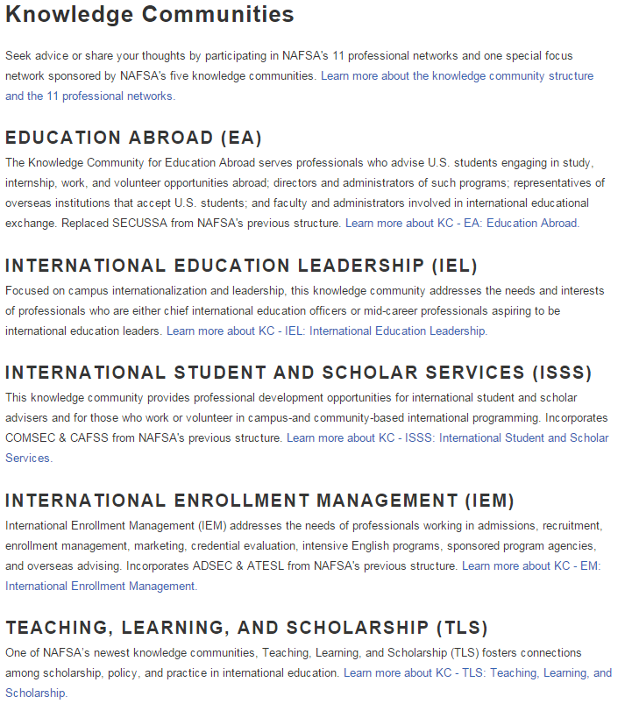
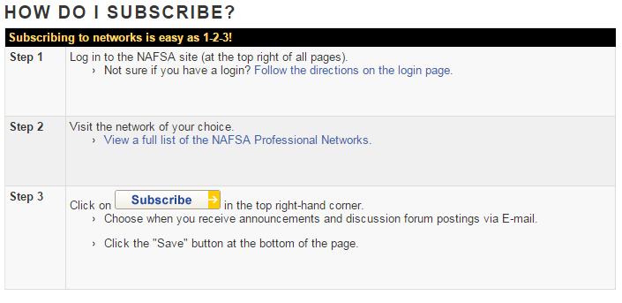
NAFSA: Networking Strategies
Knowledge Communities
http://www.nafsa.org/Connect_and_Network/Engage_with_a_Community/Using_NAFSA_Networks/

Slide 37
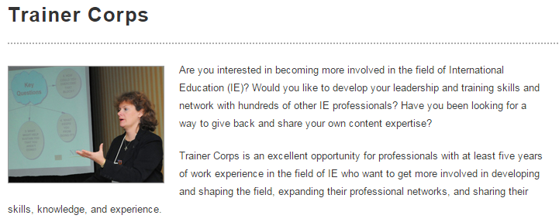
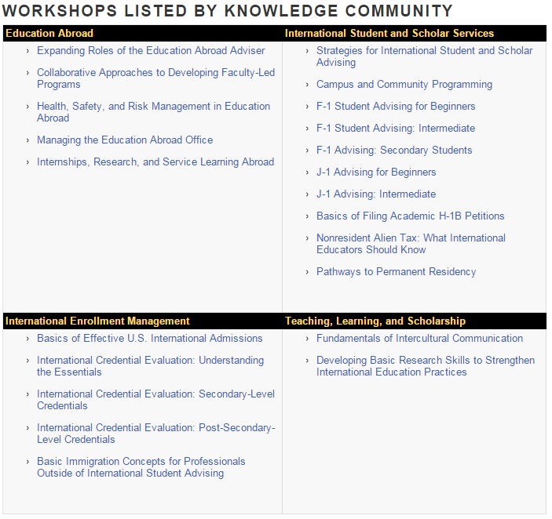
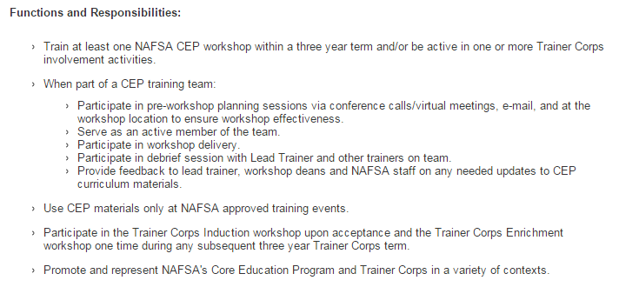
NAFSA: Networking Strategies
Trainer Corps
Notes:
CEP: Core Education Program
To get started, you apply to be a member of trainer corps. Applications usually come out in November. Once selected, you attend a training at the next annual conference. Then, you're on a list of trainers available to conference organizers for national and regionals. Occasionally, regional conference trainers may select non-trainer corps individuals to participate in training teams, but typically just at the regional level.

Slide 38
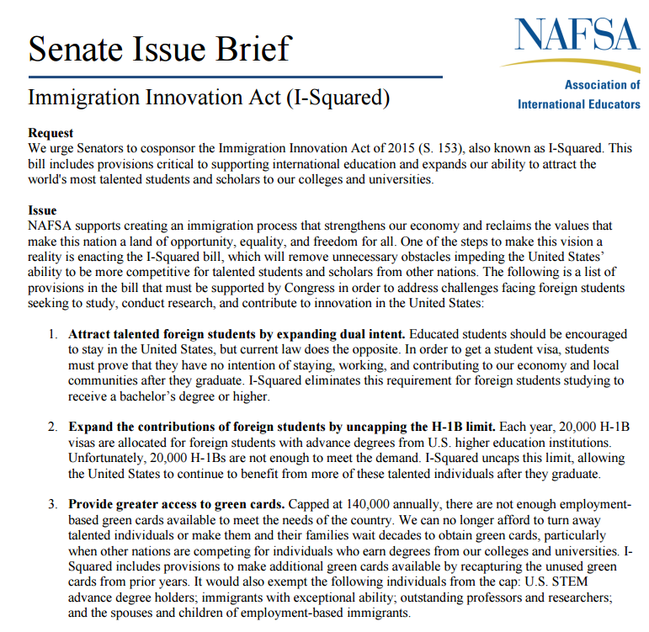
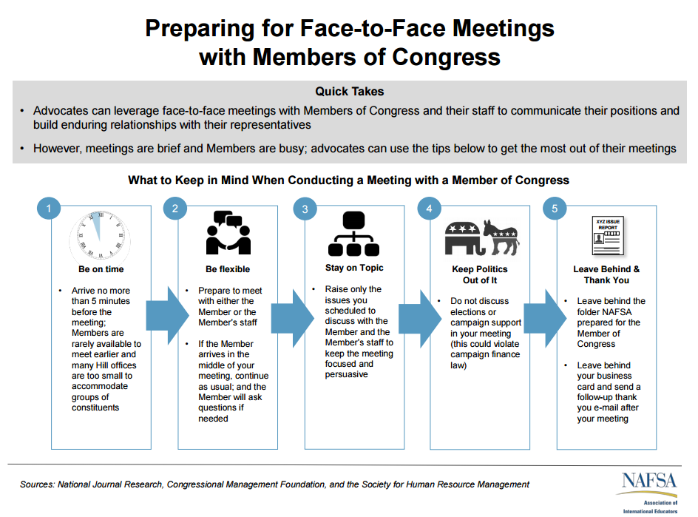
NAFSA: Networking Strategies
Advocacy
Earlybird Registration Deadline: January 31, 2015
http://www.nafsa.org/Attend_Events/Advocacy/Advocacy_Day/Advocacy_Day_2016/
Notes:
bring it back to local, build your reputation, someone who genuinely cares!!!!

Slide 39
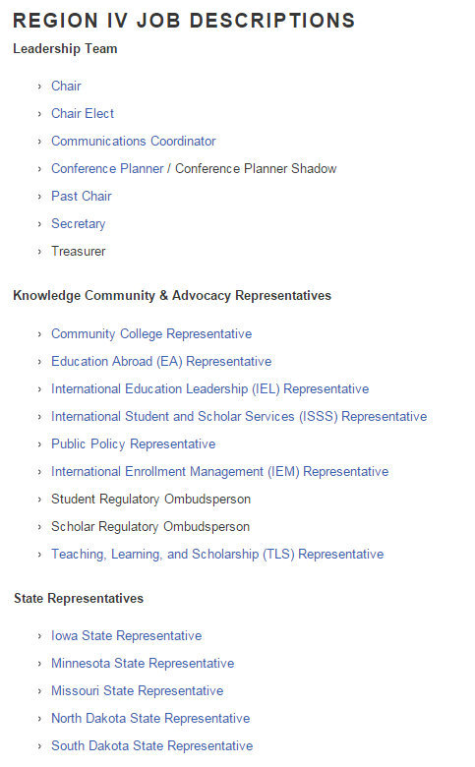
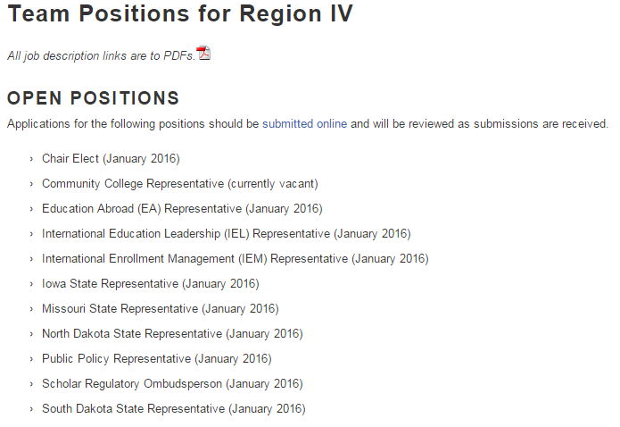
NAFSA: Networking Strategies
Team Positions
http://www.nafsa.org/Connect_and_Network/Engage_with_a_Community/NAFSA_Regions/Region_IV/About/Team_Positions_for_Region_IV/
Notes:
check with the current team! - state level positions are a GREATTTT way to start

Slide 40
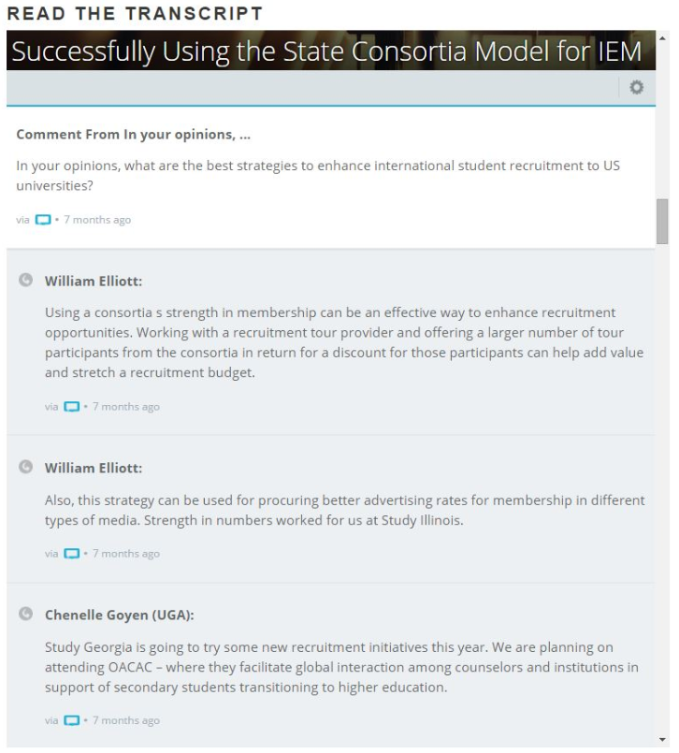
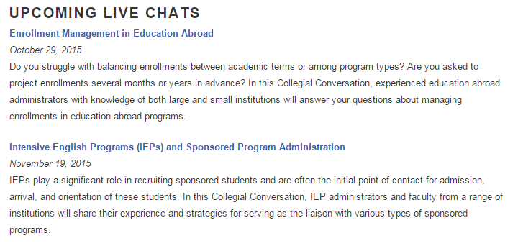
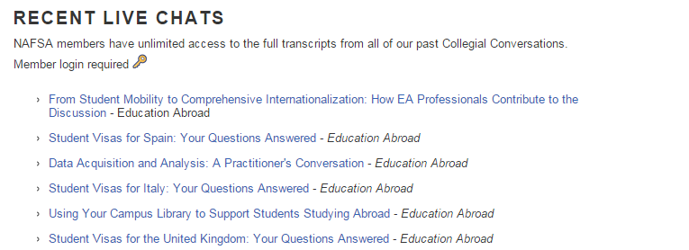
NAFSA: Networking Strategies
Collegial Conversations - NAFSA
http://www.nafsa.org/Connect_and_Network/Join_a_Conversation/Collegial_Conversations/
Notes:
free for NAFSA members

Slide 41
GENERAL FIELD KNOWLEDGE & RESOURCES
Connecting outside of NAFSA
International, National, Regional, and State levels
Young Professional Networks
Notes:
Attending other local and national conferences outside NAFSA
National: AACRAO, NAGAP, Forum for Study Abroad, TAICEP
Local: IEI and WAIE (Illinois), UMACRAO (Minnesota), Iowa International Educators (Iowa), MACRAO (Missouri), etc.

Slide 42
GENERAL FIELD KNOWLEDGE & RESOURCES:
International Level

Slide 43
GENERAL FIELD KNOWLEDGE & RESOURCES:
National Level
http://www.aacrao.org/home
http://www.nagap.org/

Slide 44
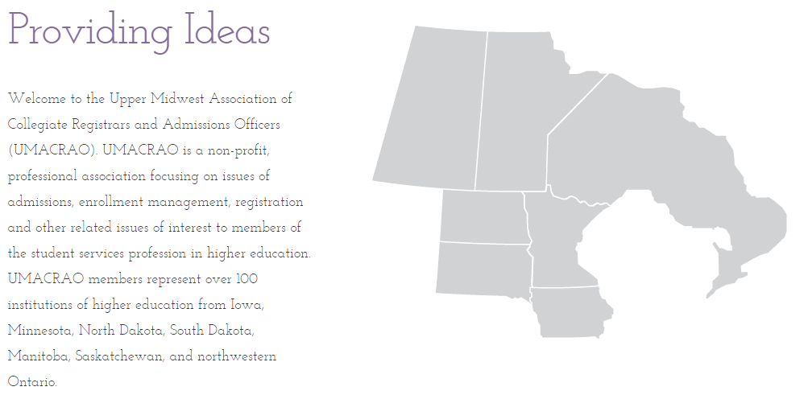
GENERAL FIELD KNOWLEDGE & RESOURCES:
Regional Level
http://www.umacrao.com/
http://www.miiie.org/

Slide 45
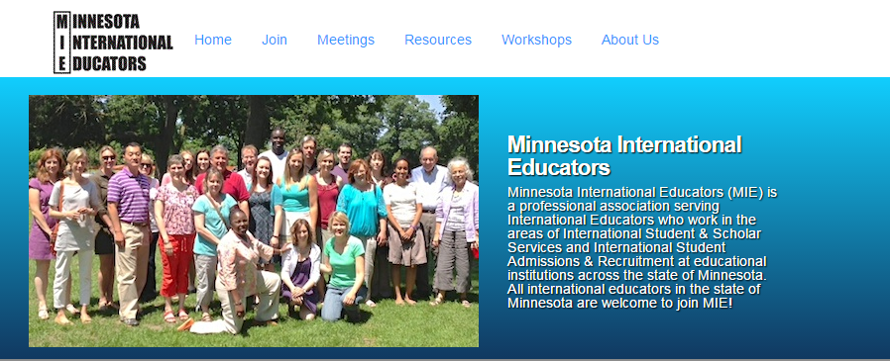
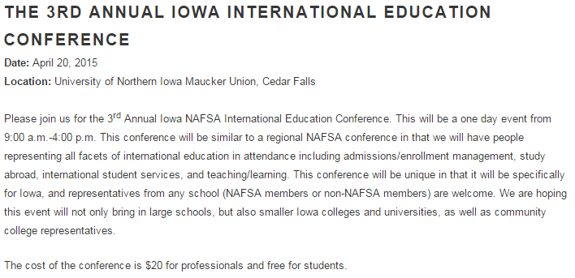
GENERAL FIELD KNOWLEDGE & RESOURCES:
State Level
http://studymissouri.net/
http://ieillinois.org/iei/
http://mn-mie.com/

Slide 46
GENERAL FIELD KNOWLEDGE & RESOURCES:
Young Professional Networks

Slide 47
SUGGESTED RESOURCES AND BOOKMARKS
Chronicle of Higher Education and Global Newsletter (http:chronicle.com/section/Newsletters/85)
Institute of Higher Education
Inside Higher Ed
NAFSA Blog (http:blog.nafsa/org)
PIE News (thepienews.com)
Better Abroad (betterabroad.org)
What’s Up with Culture (www2.pacific.edu/sis/culture/)
Institute for Higher Education Policy (ihep.org)

Slide 48
JOB BOARDS AND RESOURCES
Inside Higher Ed Jobs (higheredjobs.com; careers.insidehighered.com)
Chronicle of Higher Education (chroniclevitae.com/job_search/new)
NAFSA Career Center and Job Registry (jobregistry.nafsa.org/jobs)
The Pie Jobs (thepiejobs.com)
TIE Online (tieonline.com)
AACRAO Jobs Online (jobs.aacrao.org)

Slide 49
MENTORING
Benefits of a Mentor
Where to Find Mentors?
Undergrad Experience
Information Interviews
International Educator Groups
NAFSA Conferences/Workshops
NAFSA Academy

Slide 50
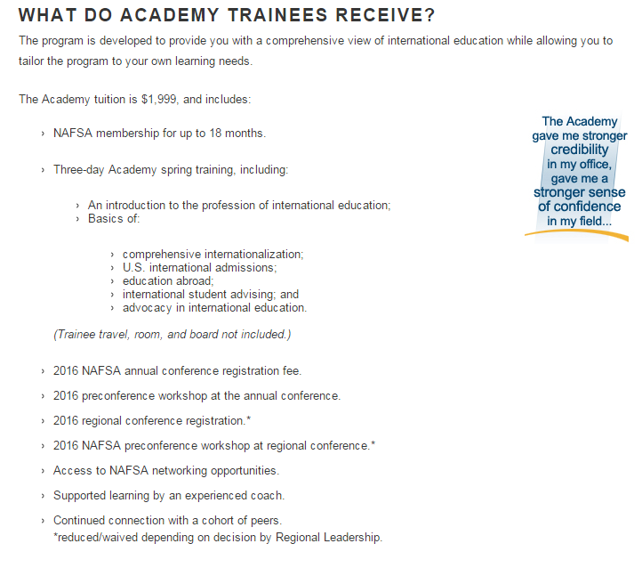
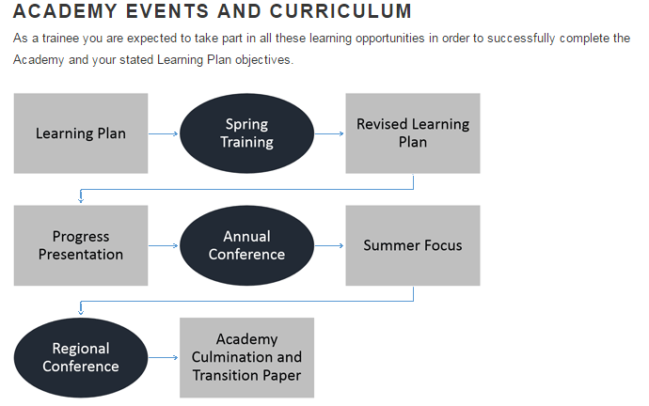
MENTORING: NAFSA ACADEMY
Notes:
formal training - cheaper than a master’s and well known in the field; a nice alternative to tuition reimbursement.

Slide 51
MOCK NETWORKING ‘RECEPTION’
How did you get your first job?
What is your 2 minute pitch?
When you meet someone new at a reception, you may have 2 minutes, and need to convey who you are, what you do, and why it's worth talking to you.
Business card exchange
What are the best questions to ask? What questions have you been asked that you were impressed by?

Slide 52
QUESTIONS?

Slide 53
THANK YOU!
Contact us:
Sonya Brauchle
sbrauchle@foreigncredits.com
Mallory Ericson
mallory.ericson@worldendeavors.com
Ashley Metz
armetz@umn.edu

